Slide 1


DATA WAREHOUSE
X
ID/X Partners Data Engineer Virtual Internship Program
Nabila Putri Listyanto

Slide 2
TABLE OF CONTENTS
01
02
03
04
About Me
Case Study
Result
Contact Me

Slide 3

Nabila Putri Listyanto
ABOUT ME
ABOUT ME
Experiences
Business Analyst PT Pelindo Marine Service
Machine Learning Path
Bangkit Academy 2022
I am a final-year student from Universitas Negeri Surabaya with a strong interest in the field of data analytics, data science, and data engineering. I am eager to further develop my skills and knowledge in the world of data.
Home Credit Indonesia Data Scientist
Virtual Internship Program
ID/X Partners Data Engineer Virtual
Internship Program

Slide 4



CASE STUDY
Background
Tools
One of the clients of ID/X Partners, which operates in the e-commerce industry, has a need to create a Data Warehouse that consists of several tables from the source database. This Data Warehouse will consist of one Fact table and several Dimension tables.
These are some tools used in this project:

Slide 5
CASE STUDY: Challenges
Restore DB
Create DB
Create ETL Job
Create SP
Import/Restore of the Staging Database
Create a Database named DWH_Project and create Fact and Dimension Tables from the tables present in the Staging Database.
Create an ETL Job in the Talend application to move data from the Staging to the Data Warehouse. Specifically for the DimCustomer Table, perform data transformation by converting the data in the FirstName and LastName columns to all capital letters and then combine these columns into a single column named CustomerName.
Create a Stored Procedure (SP) to display a summary of sales orders based on the delivery status.

Slide 6
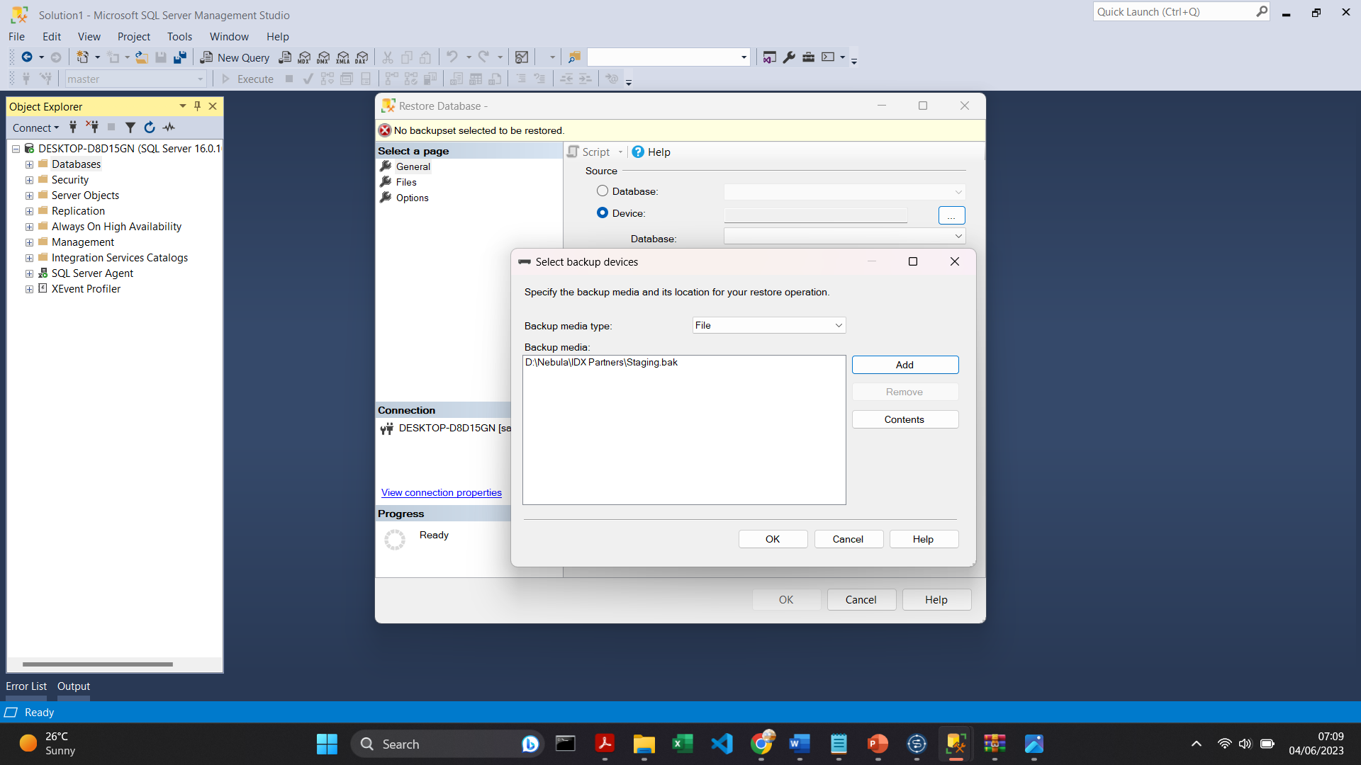
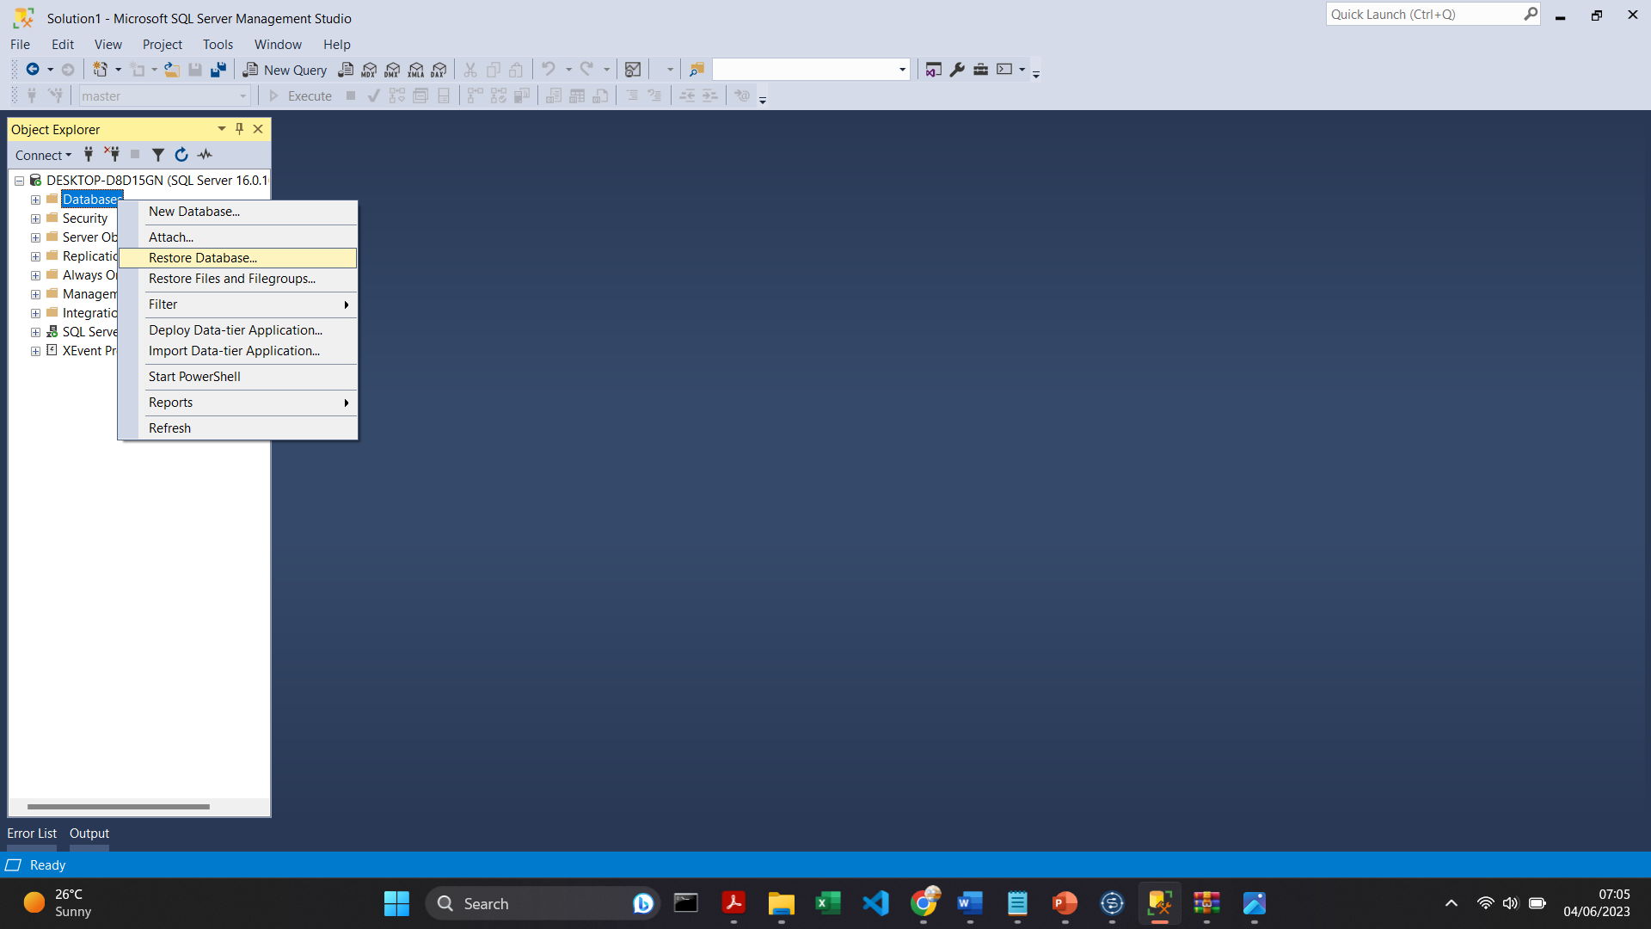
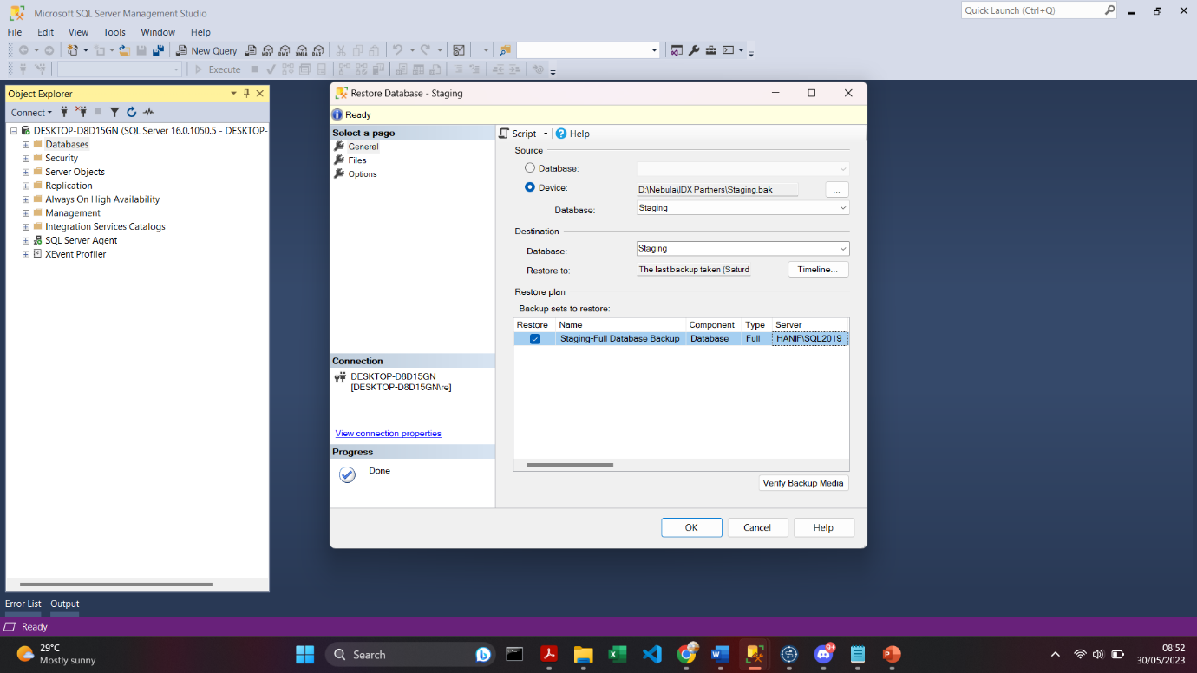
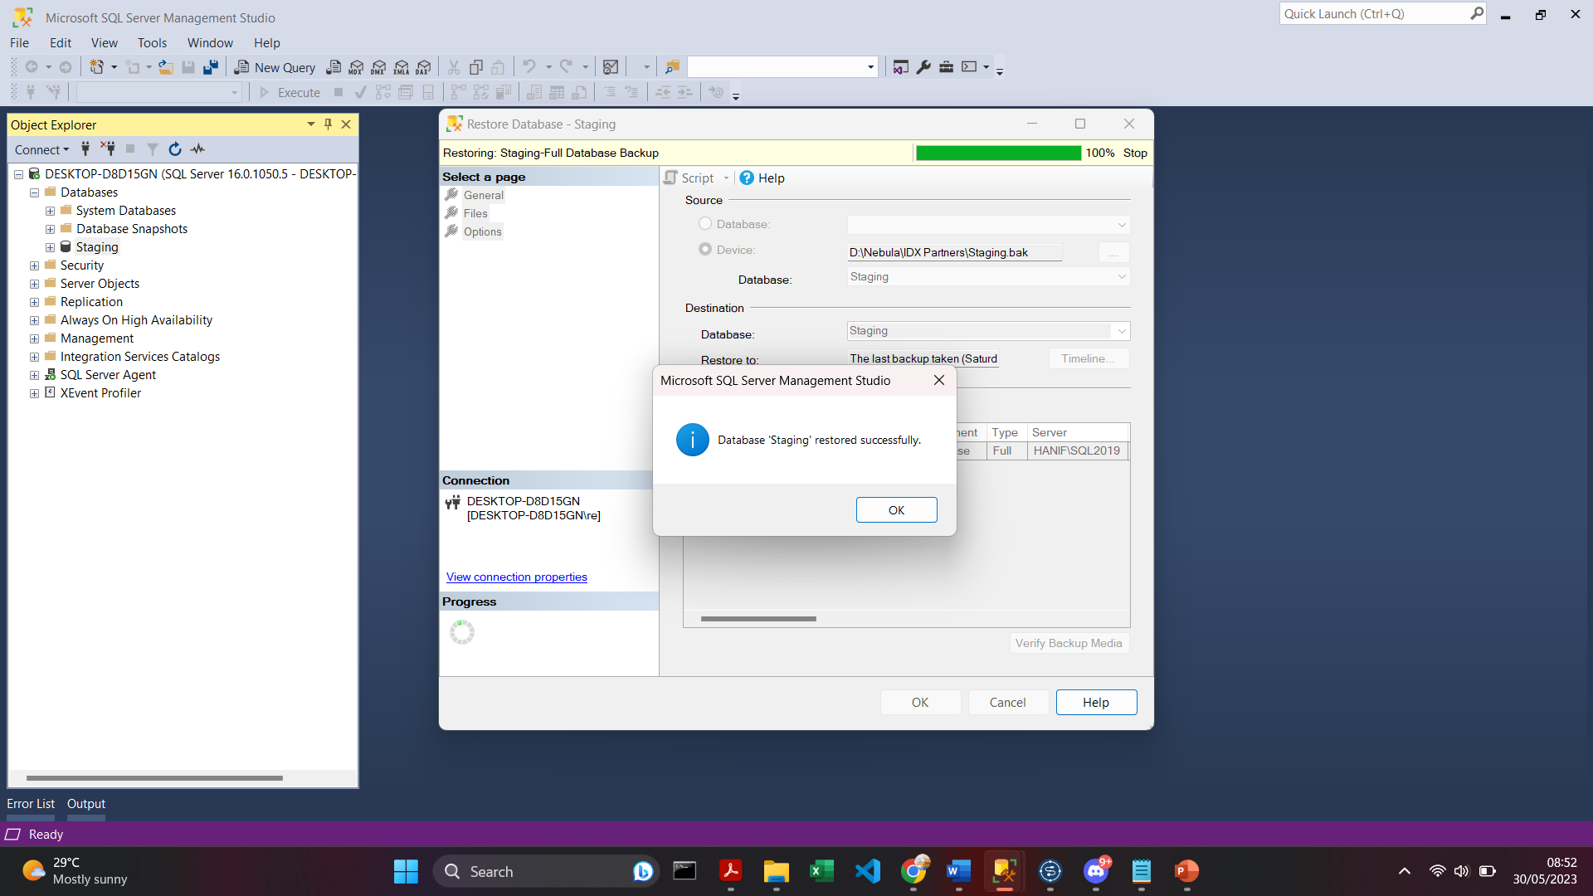
RESULT: Restore Staging DB
2
1
Object Explorer > Server > Databases > Restore Database...
Device > Click “...” > Add > OK
3
4

Slide 7
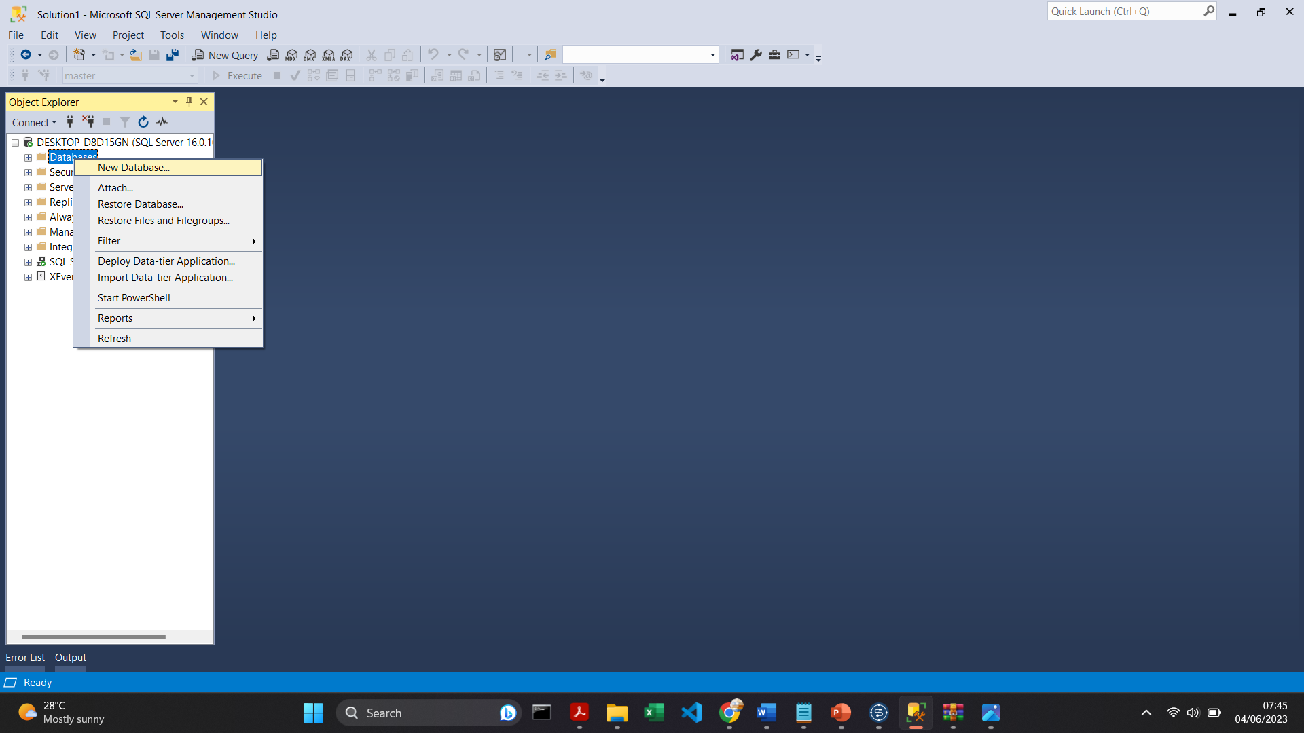
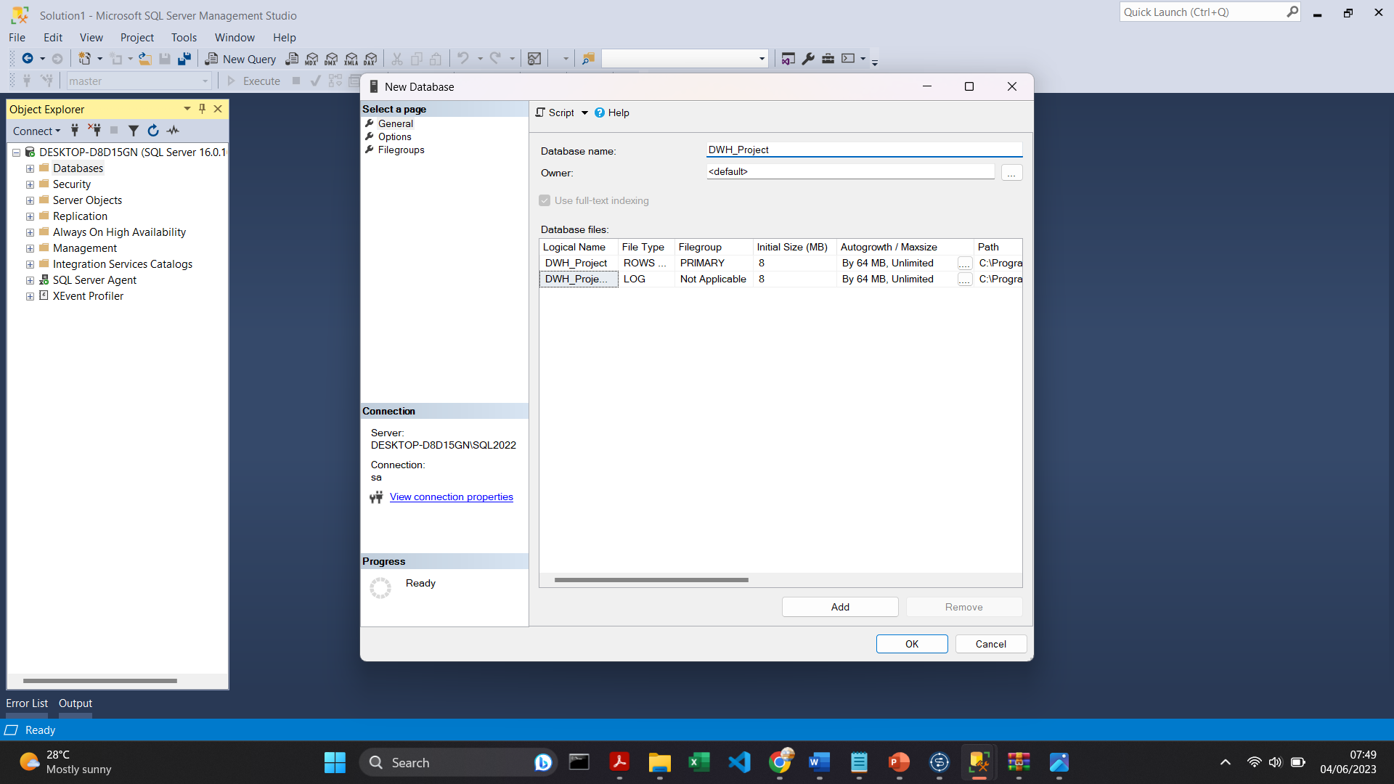
RESULT: Create DWH_Project DB
1
2
Object Explorer > Server > Databases > New Database...

Slide 8
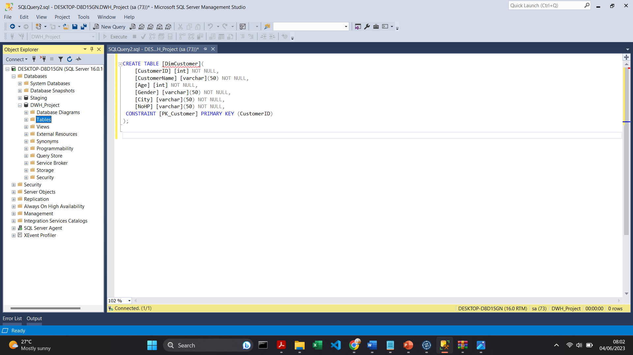
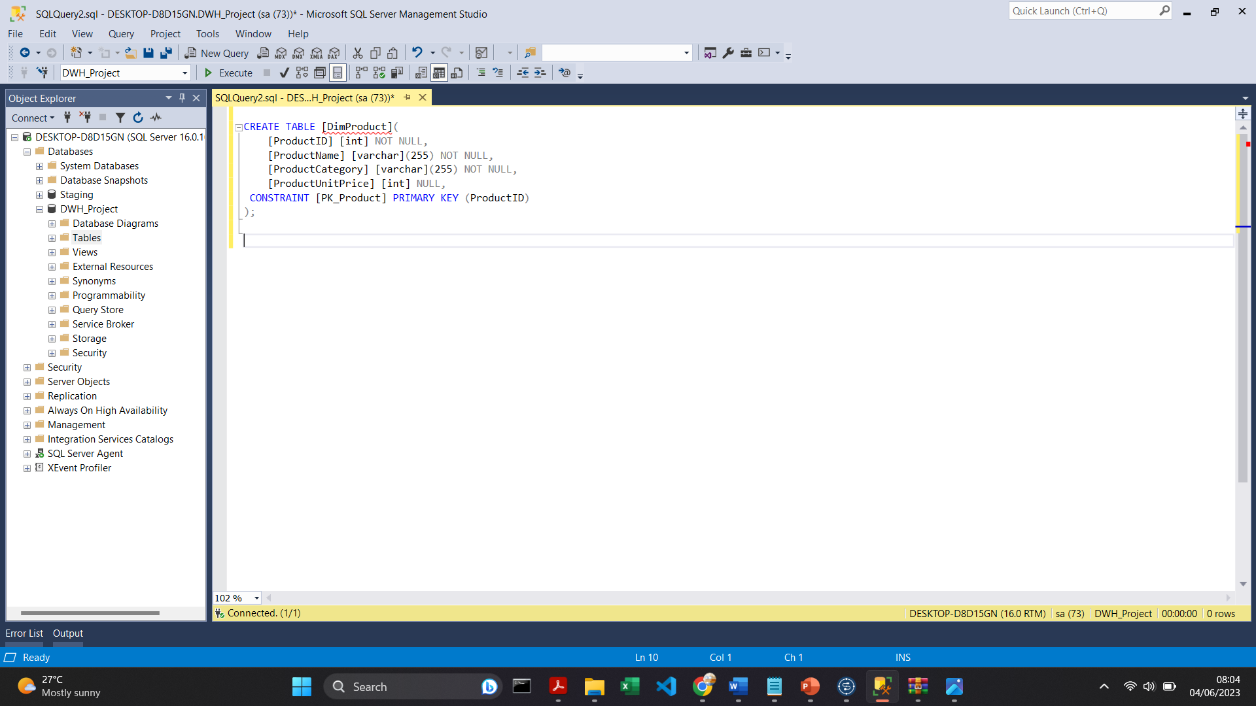
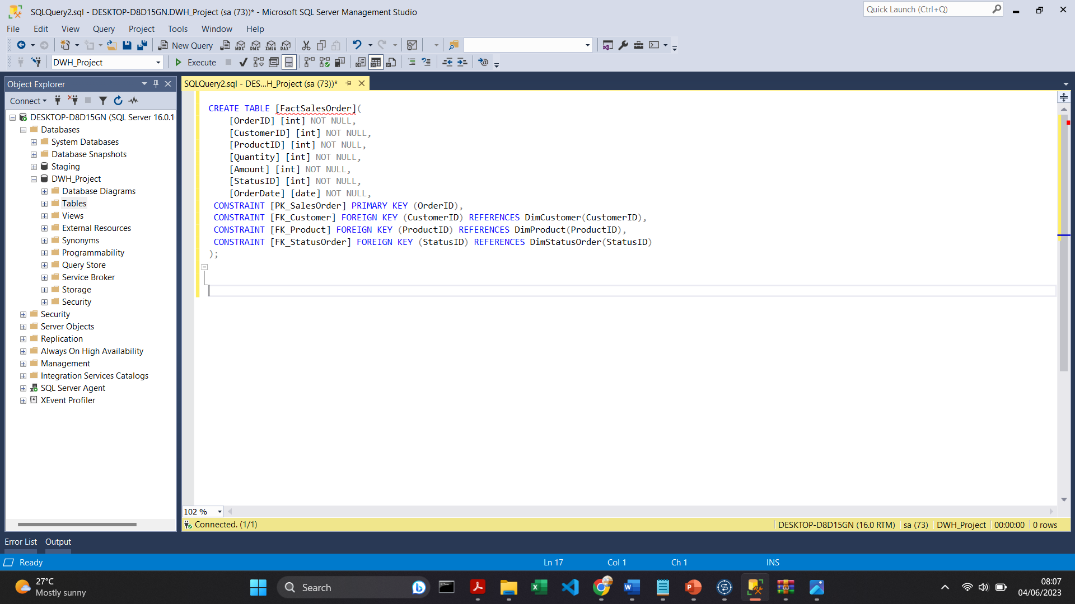
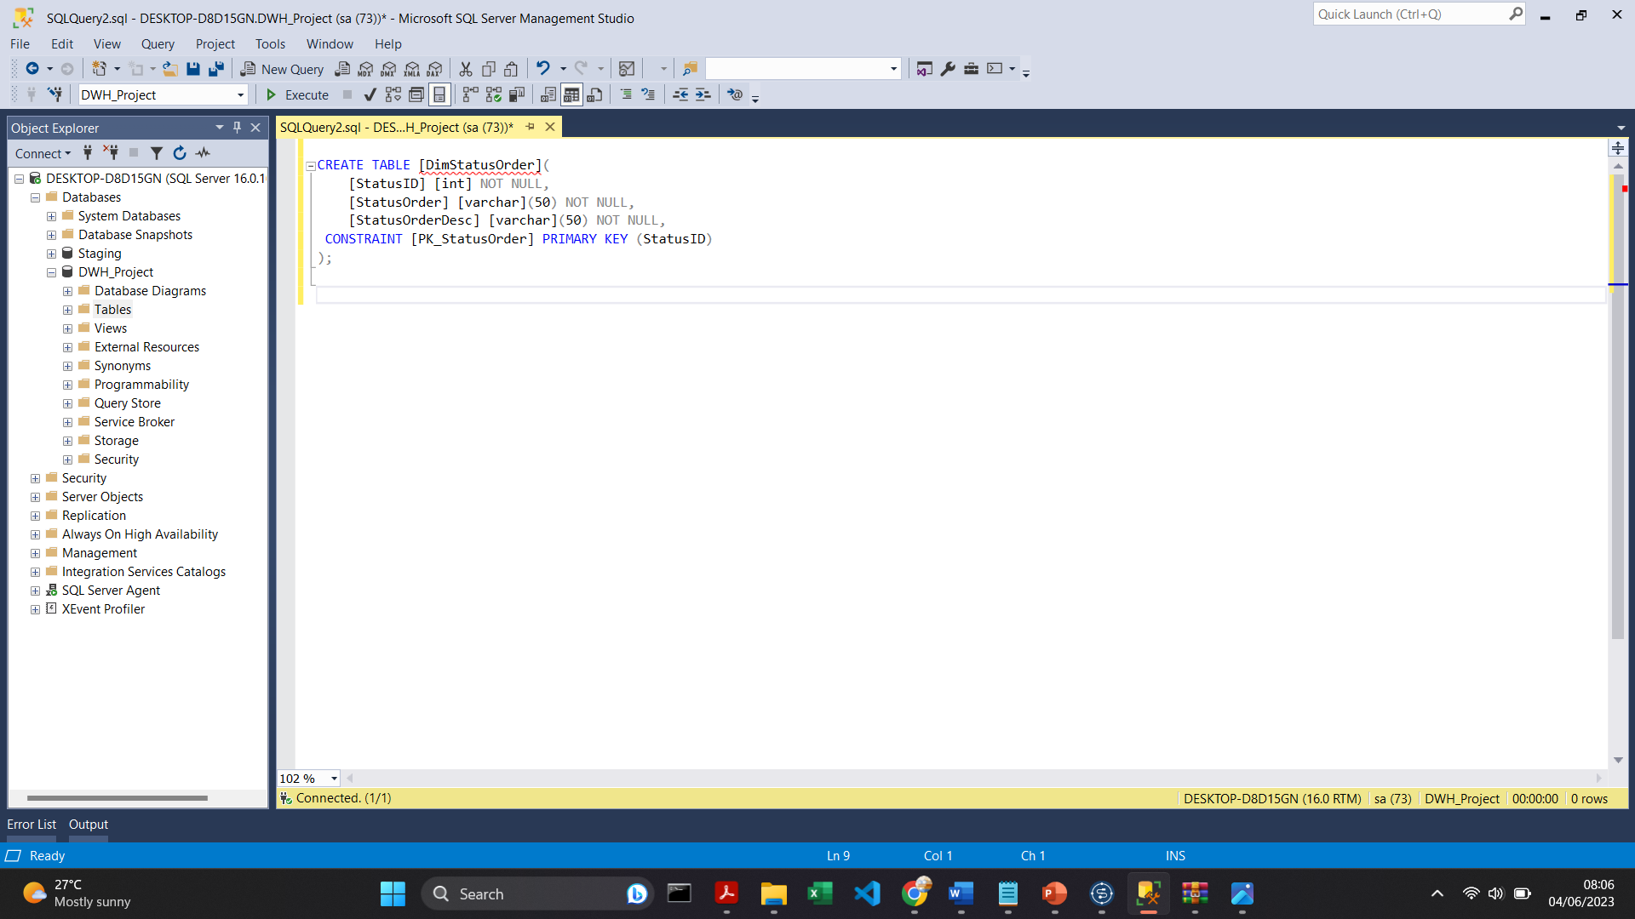
RESULT: Create Table Queries for DWH_Project DB
DimCustomer
DimProduct
FactSalesOrder
DimStatusOrder

Slide 9
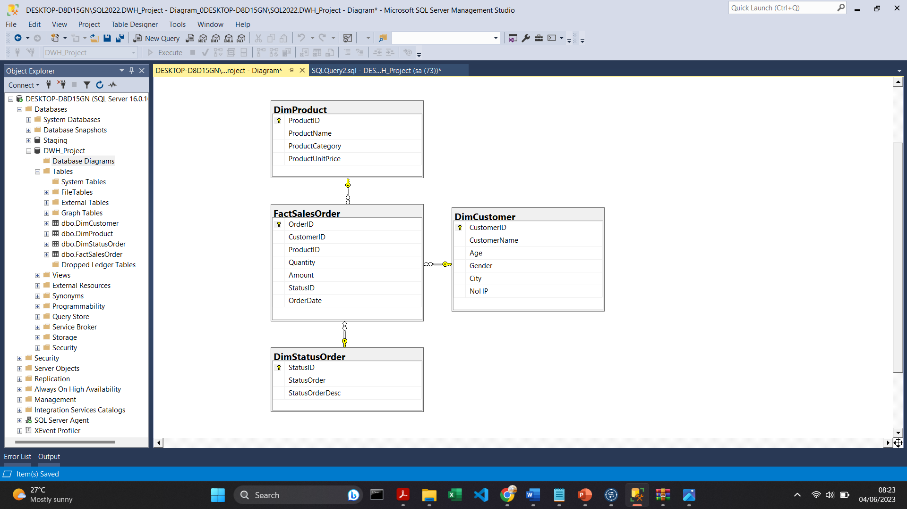
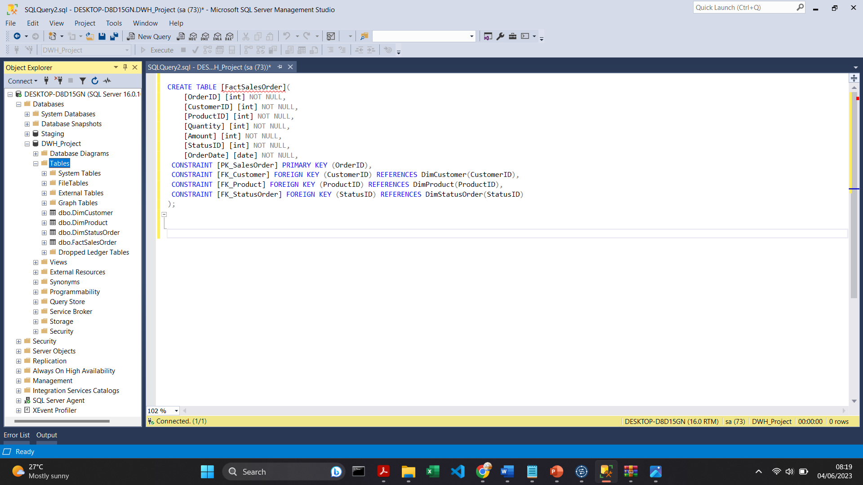
RESULT: Create Table Queries for DWH_Project DB
This is the result of creating tables using queries.
Inside the database, there are 3 master tables, namely the DimCustomer, DimProduct, and DimStatusOrder tables, and 1 transaction table, which is the FactSalesOrder table.

Slide 10
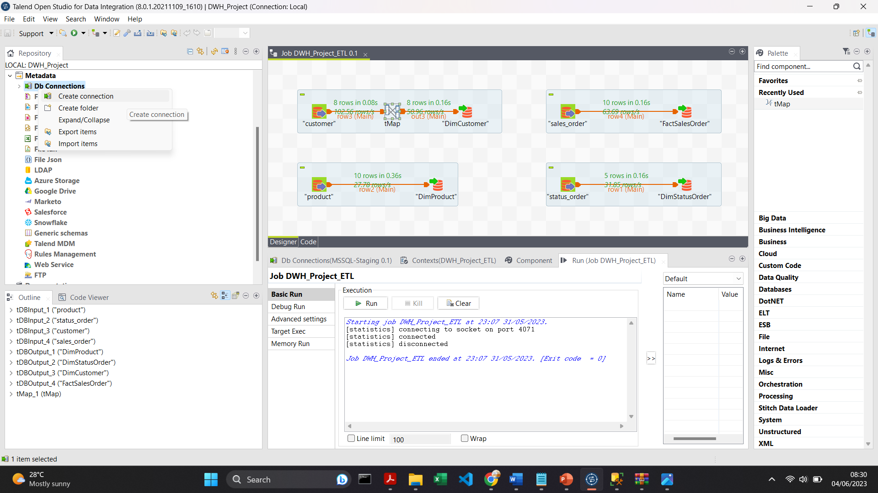
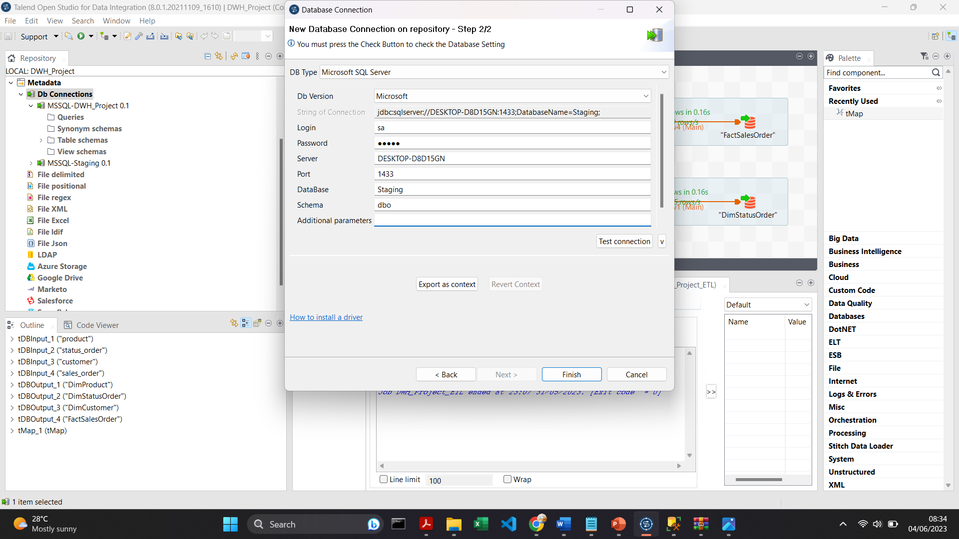
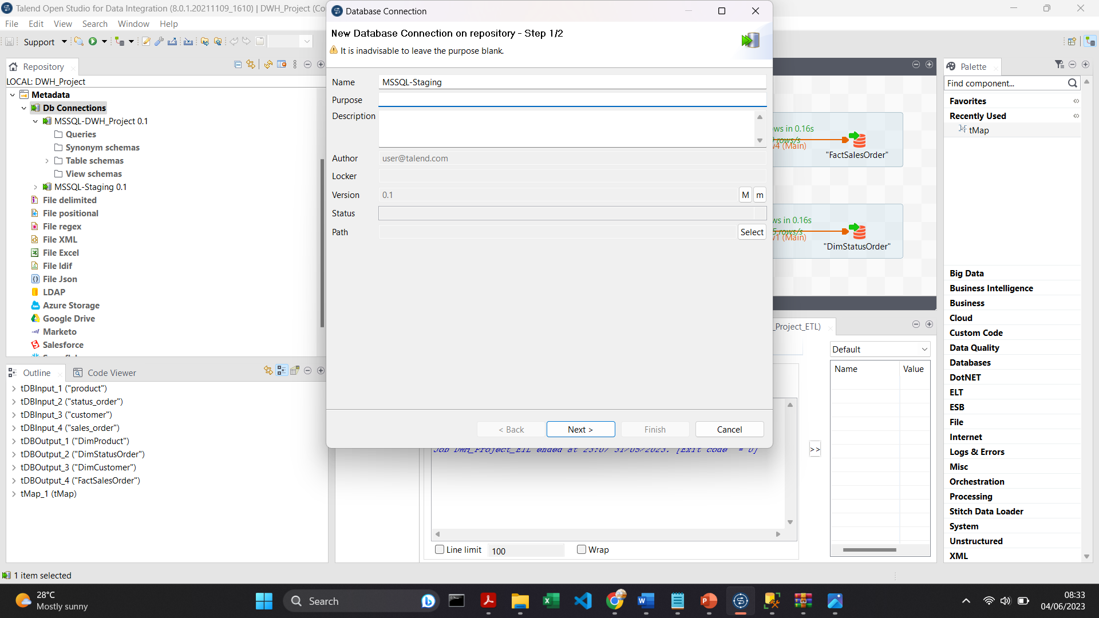
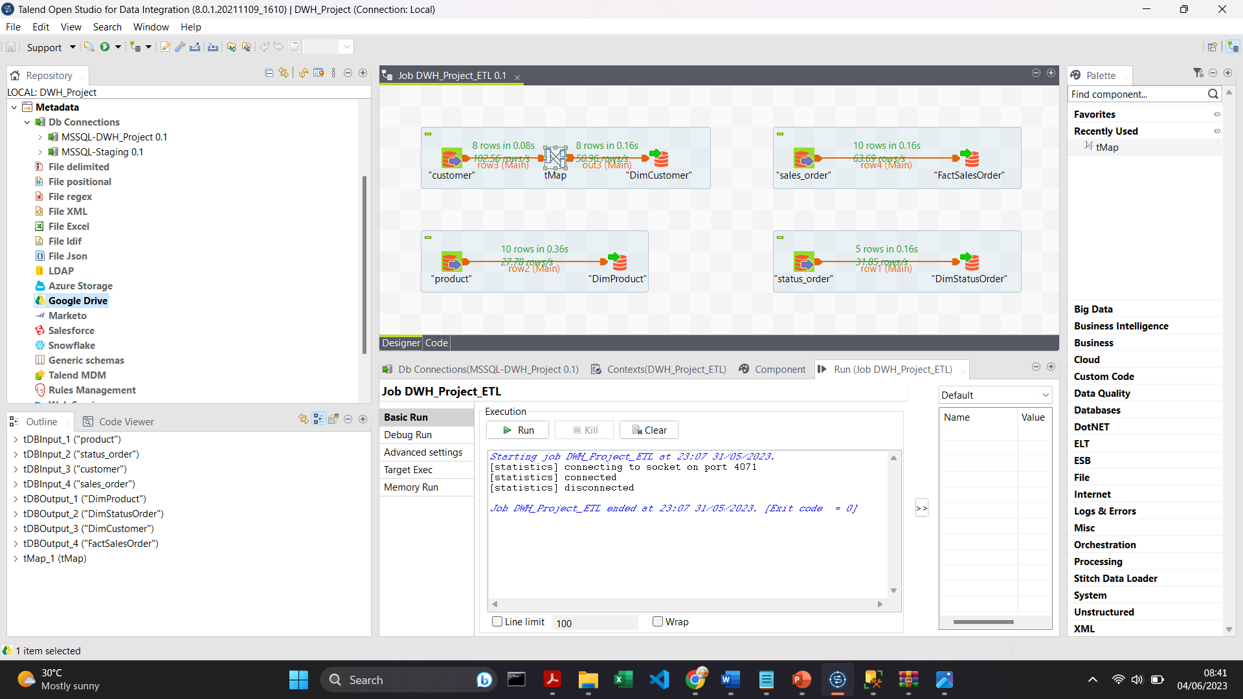
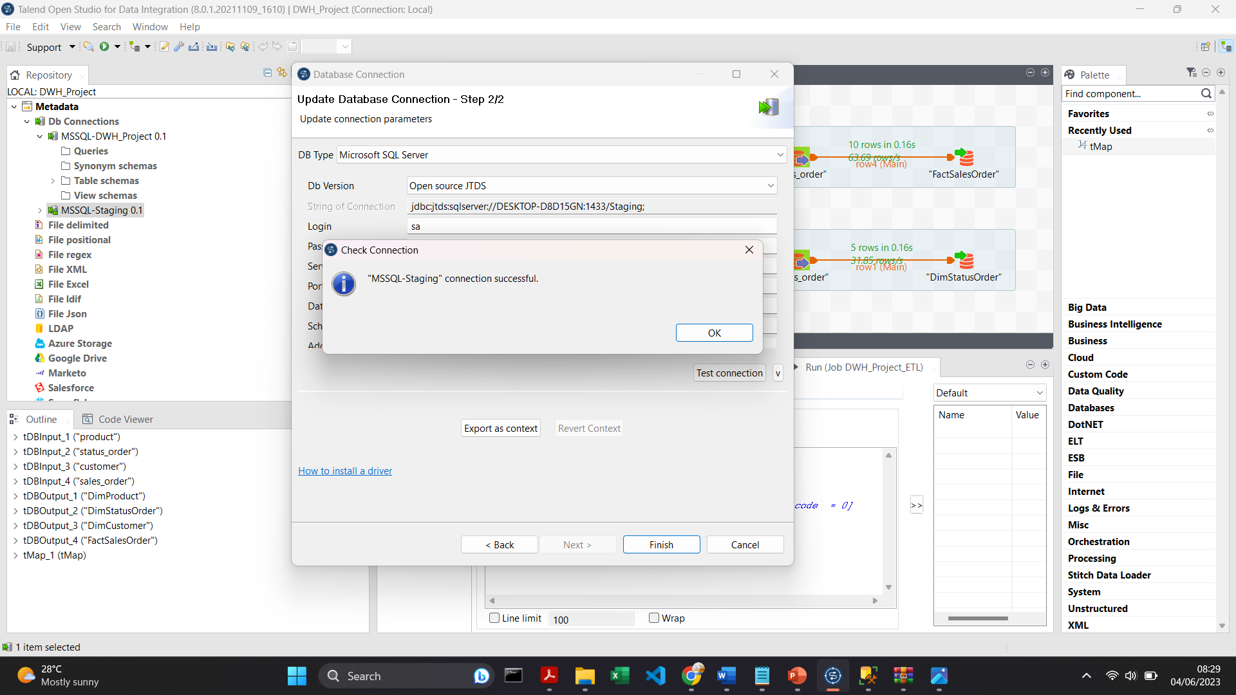
RESULT: Connect Staging DB from SQL Server to Talend
1
3
5
2
4

Slide 11

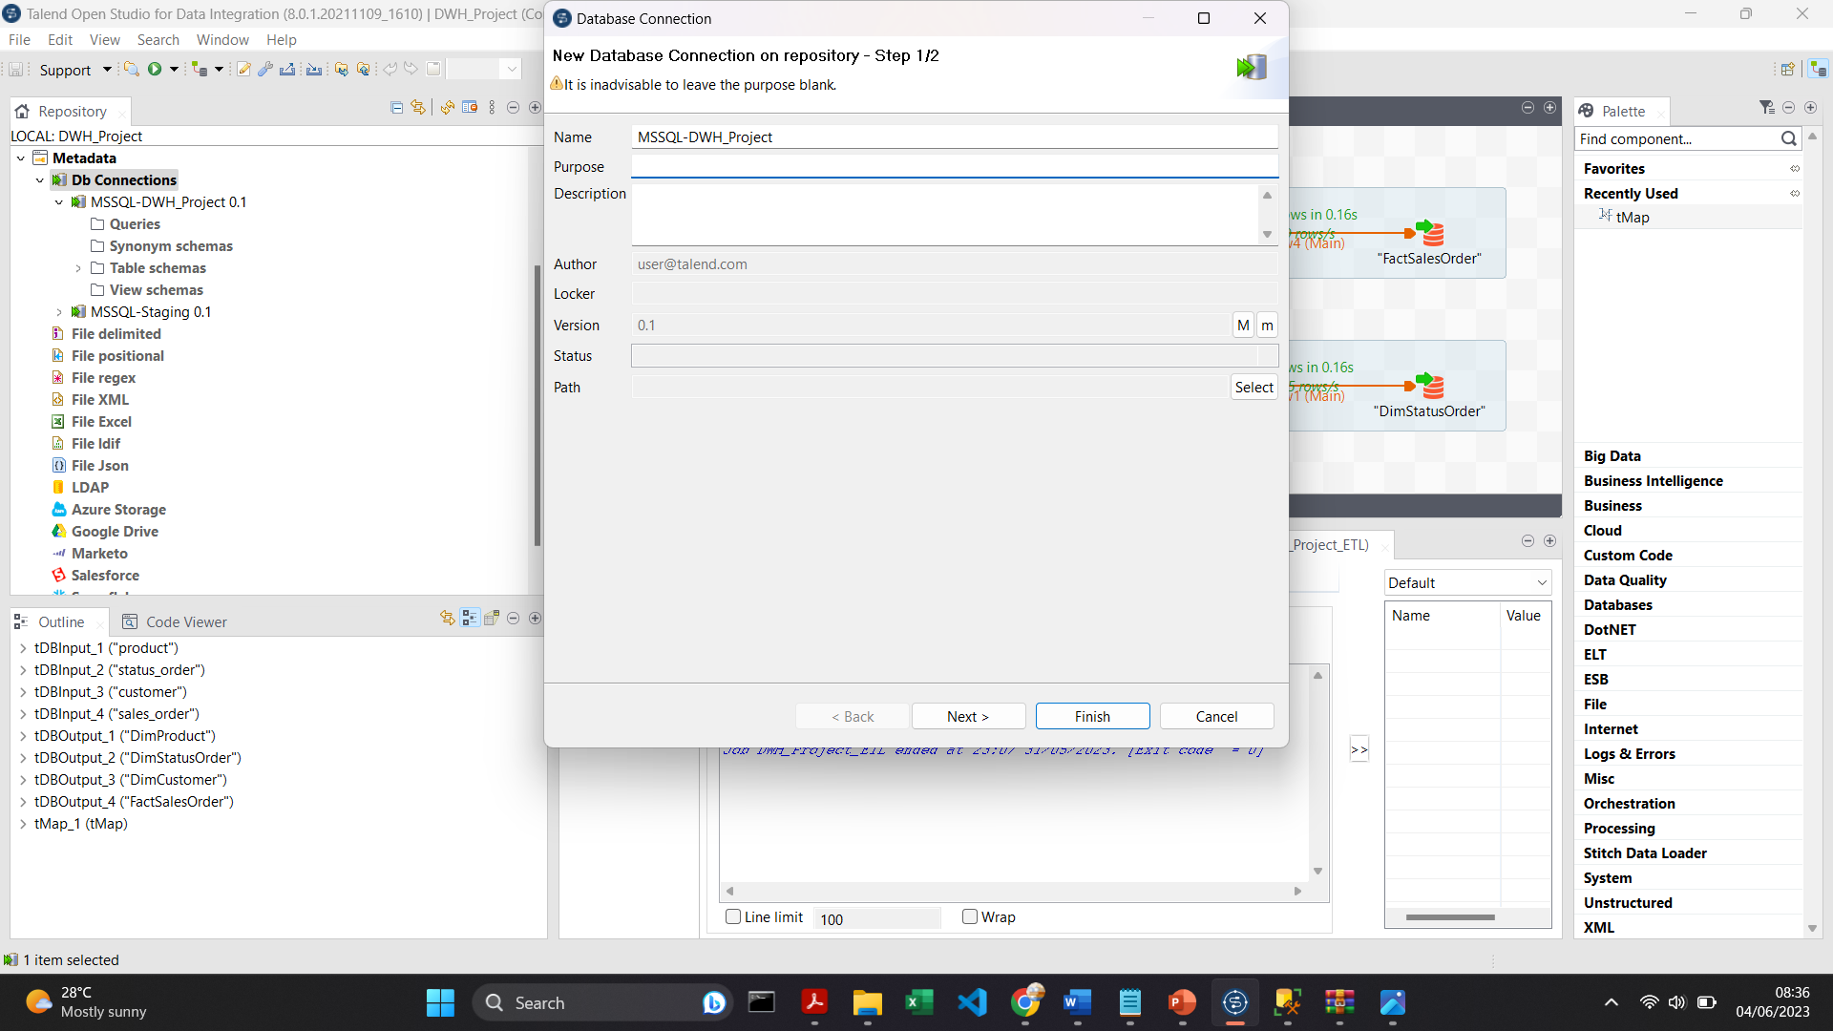
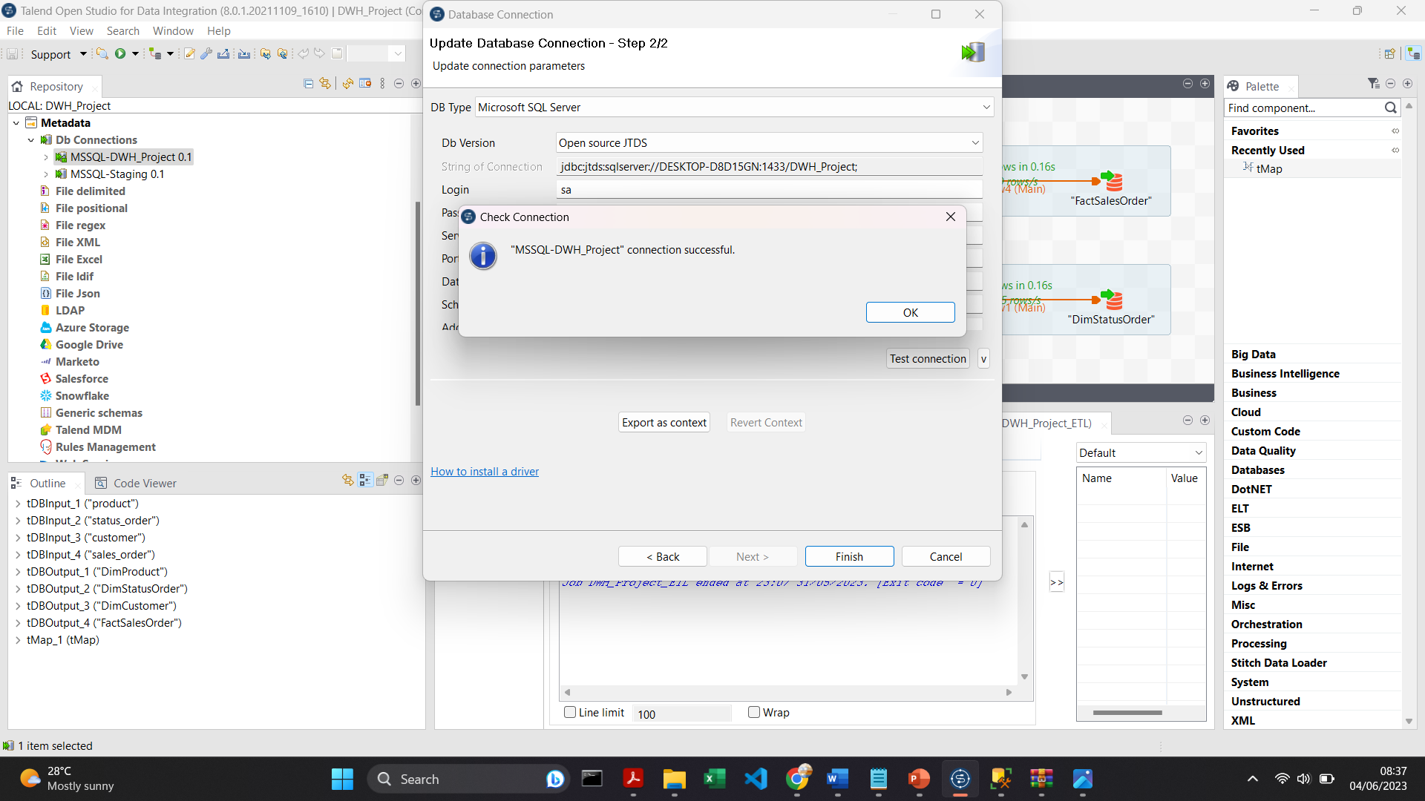
RESULT: Connect DWH_Project DB from SQL Server to Talend
1
3
5
2
4

Slide 12
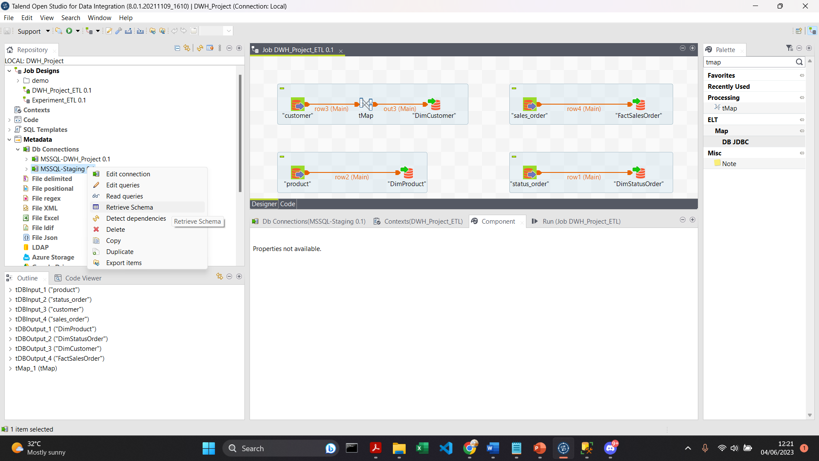
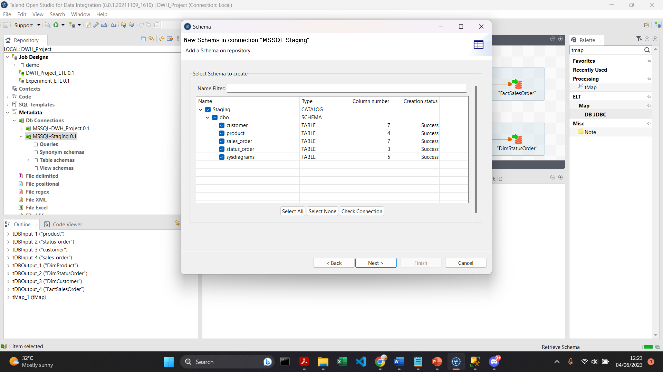
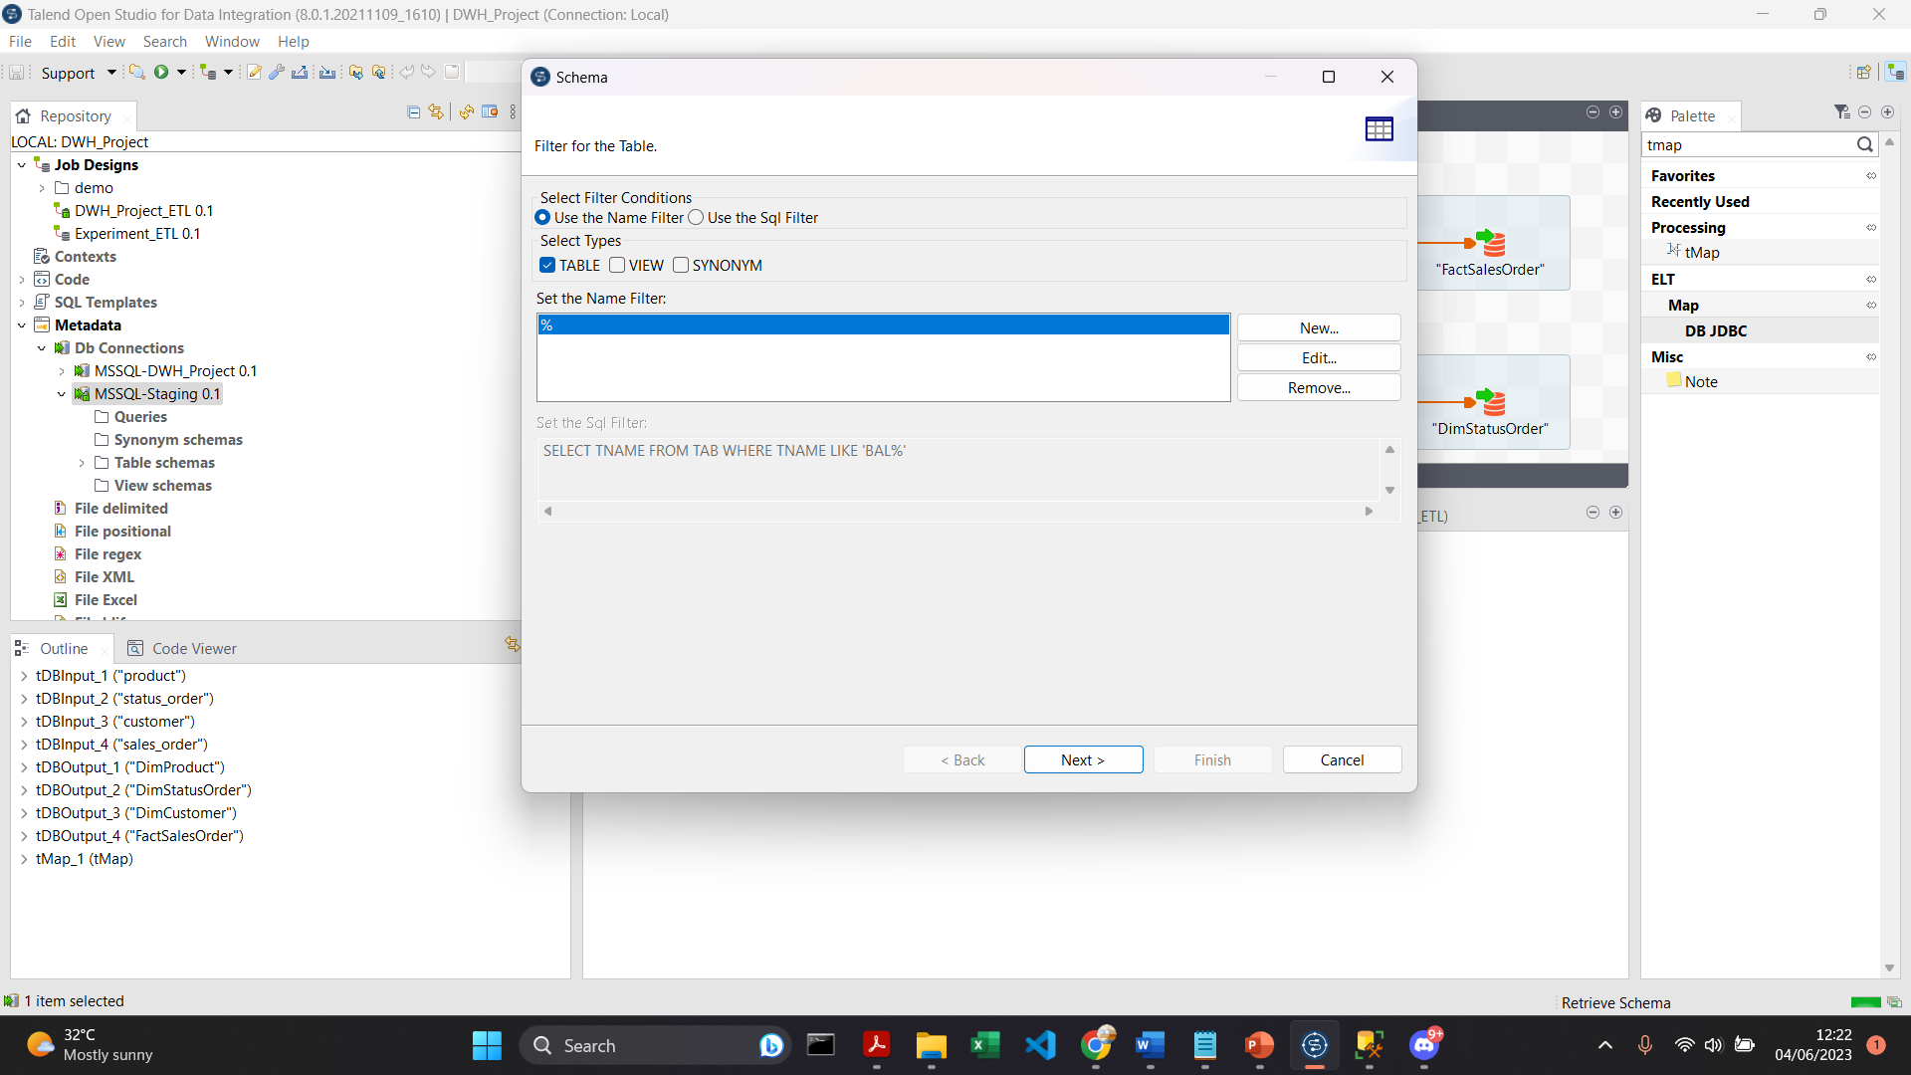
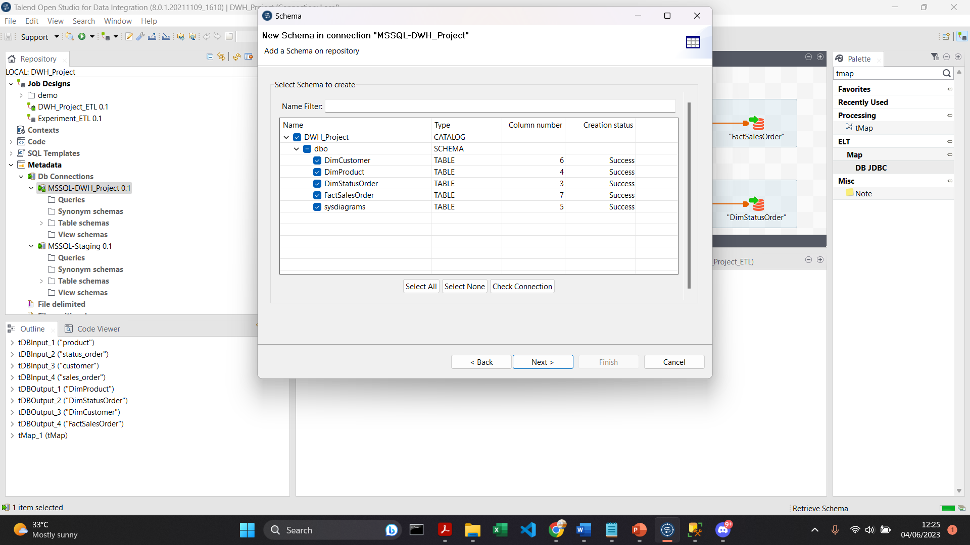
RESULT: Retrieve Schema on DB Connections

Slide 13
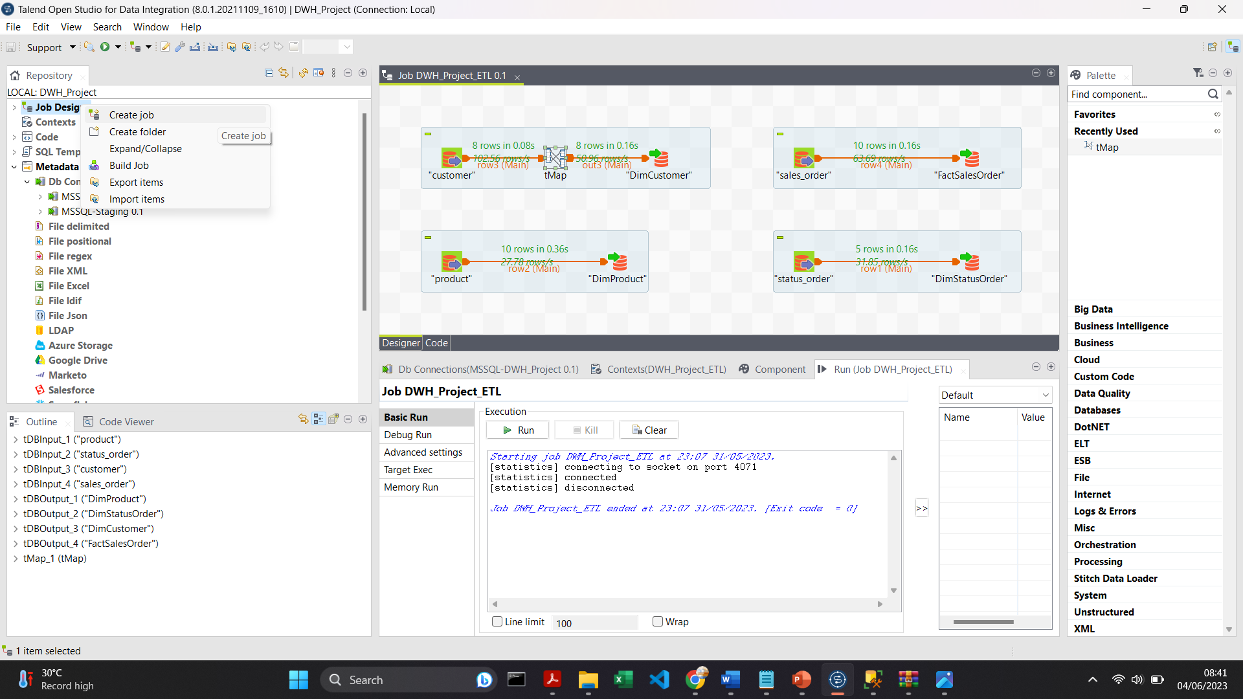
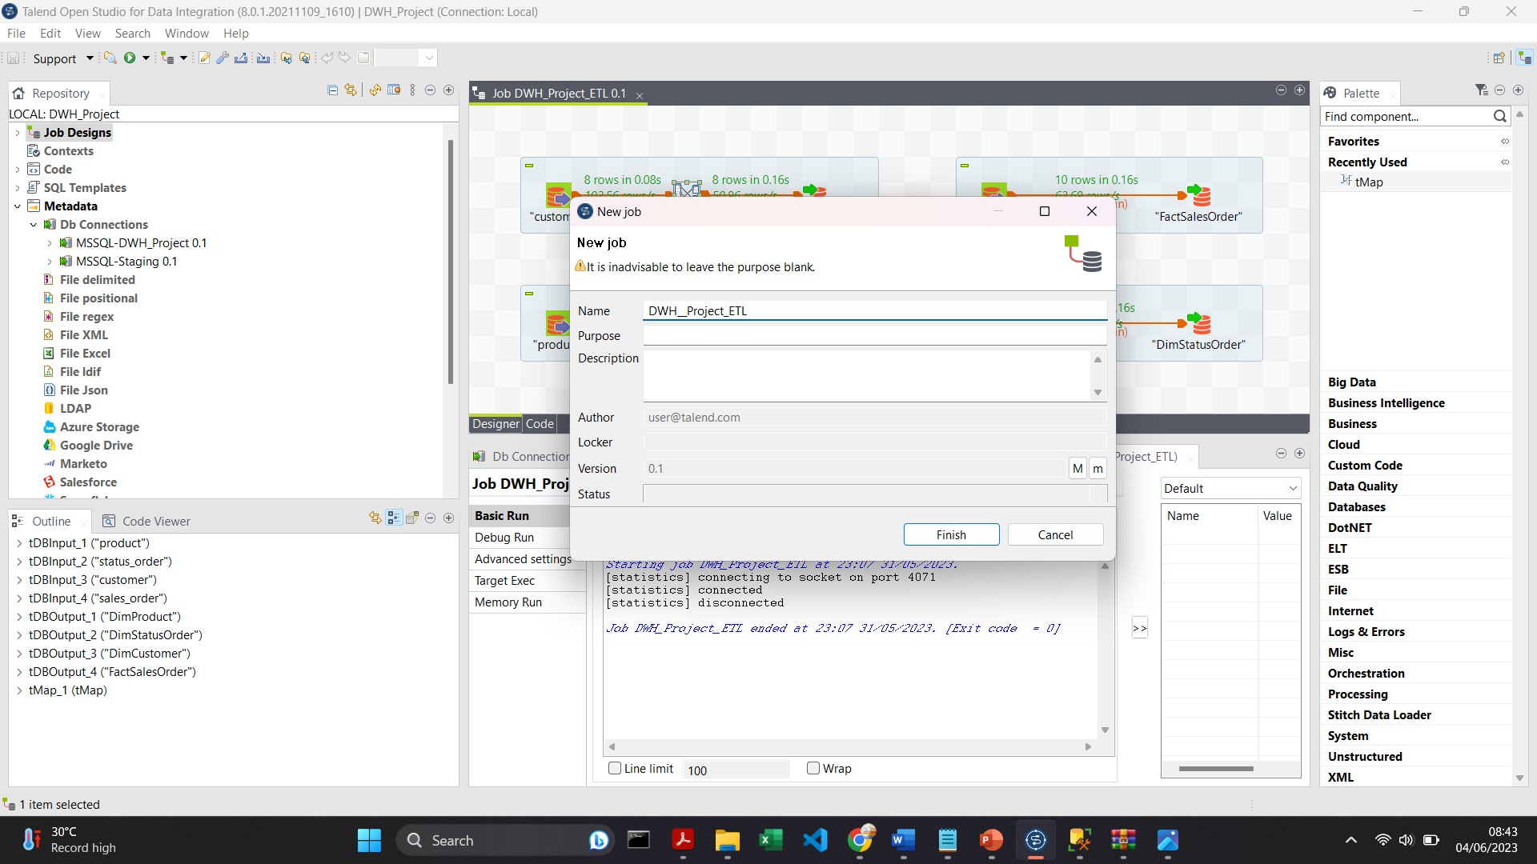
RESULT: Create an ETL Job
Job Designs > Create Job

Slide 14
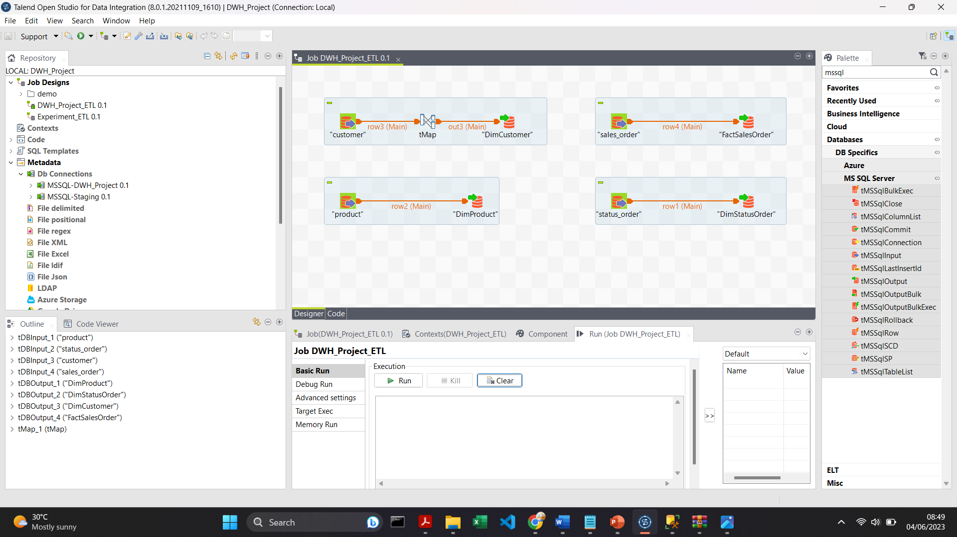
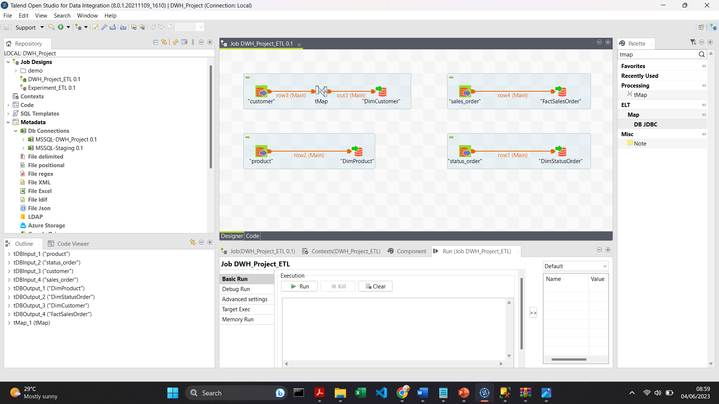

RESULT: Create Components in an ETL Job
Create a job in Talend using the tMSSqlInput and tMSSqlOutput components to move data from the source (staging) to the target (DWH_Project). However, specifically for the DimCustomer table, add another component called tMap. By using the Palette menu in Talend Studio, you can easily find and add the required components such as tMSSqlInput, tMSSqlOutput, and tMap to create the job.
Picture above is the result of creating an ETL job for all tables.

Slide 15
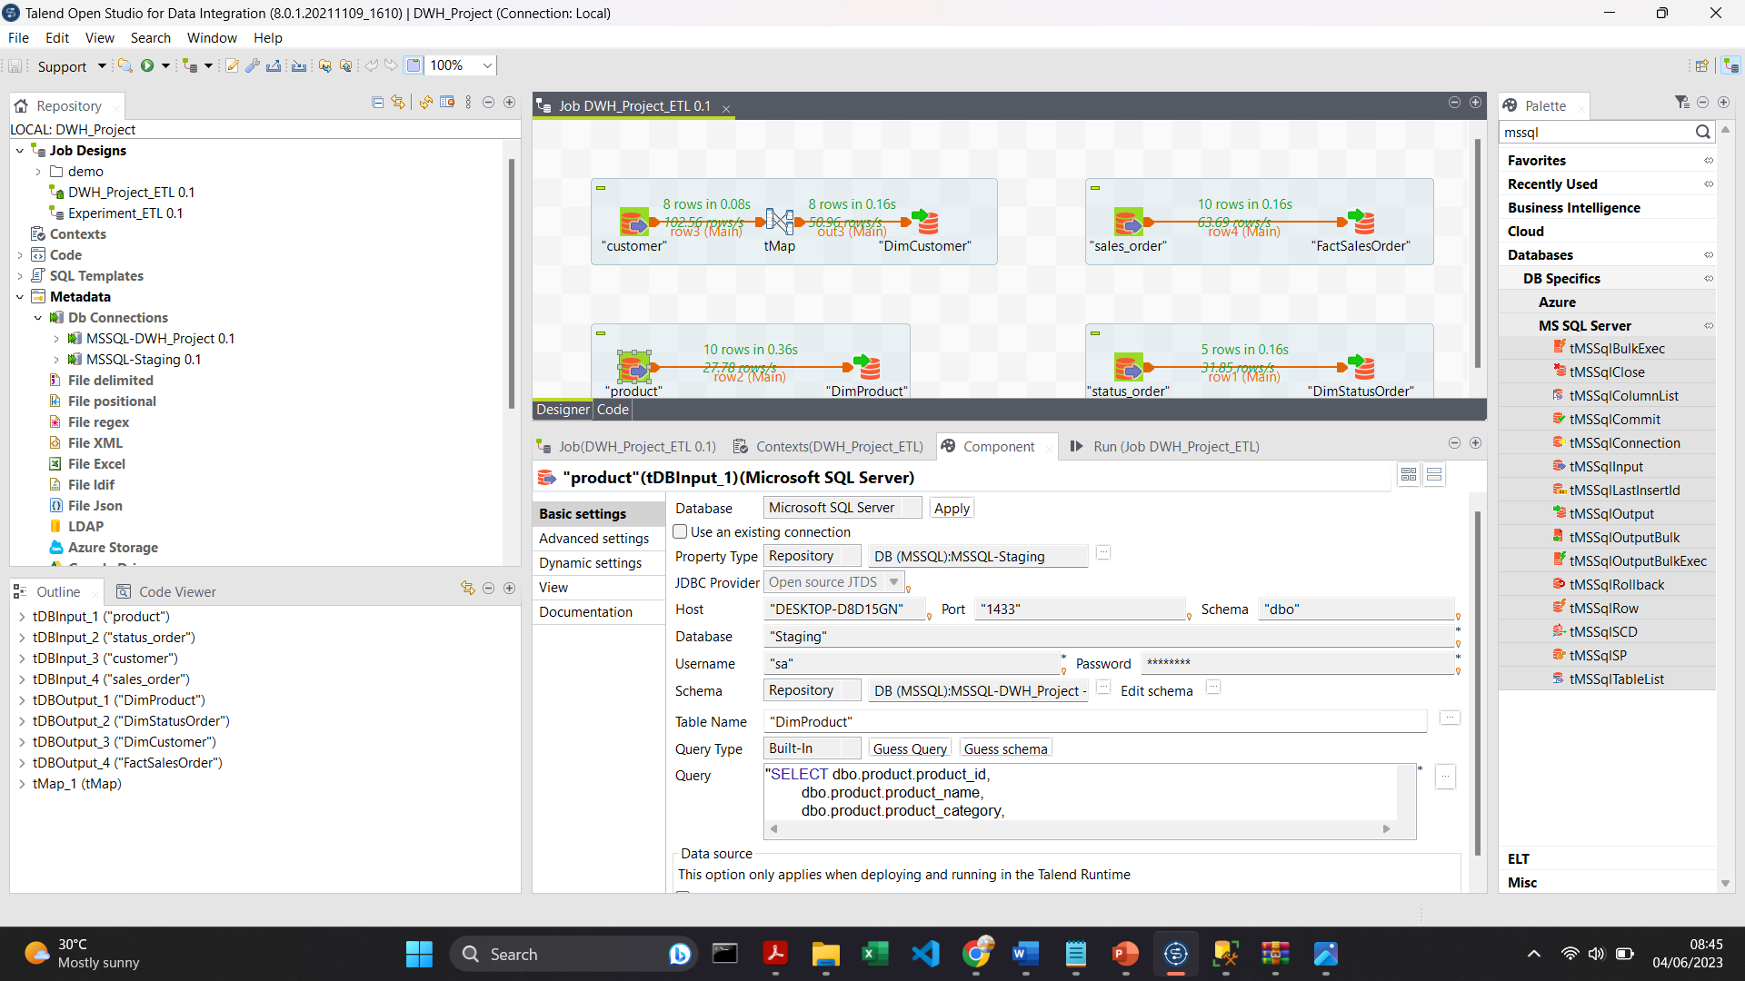
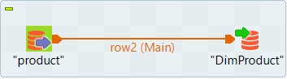
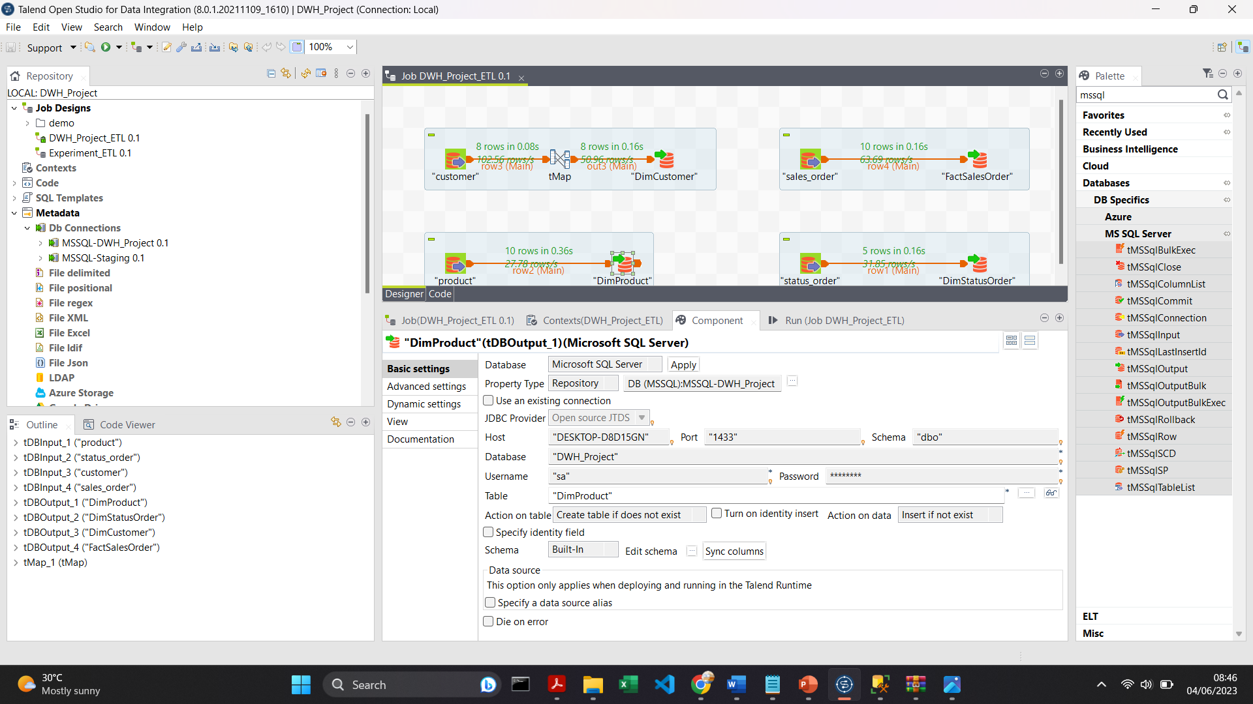
RESULT: Configure the Properties of Product Components
Adjust the properties according to databases by entering values, selecting options from drop-down menus, or configuring connections.

Slide 16
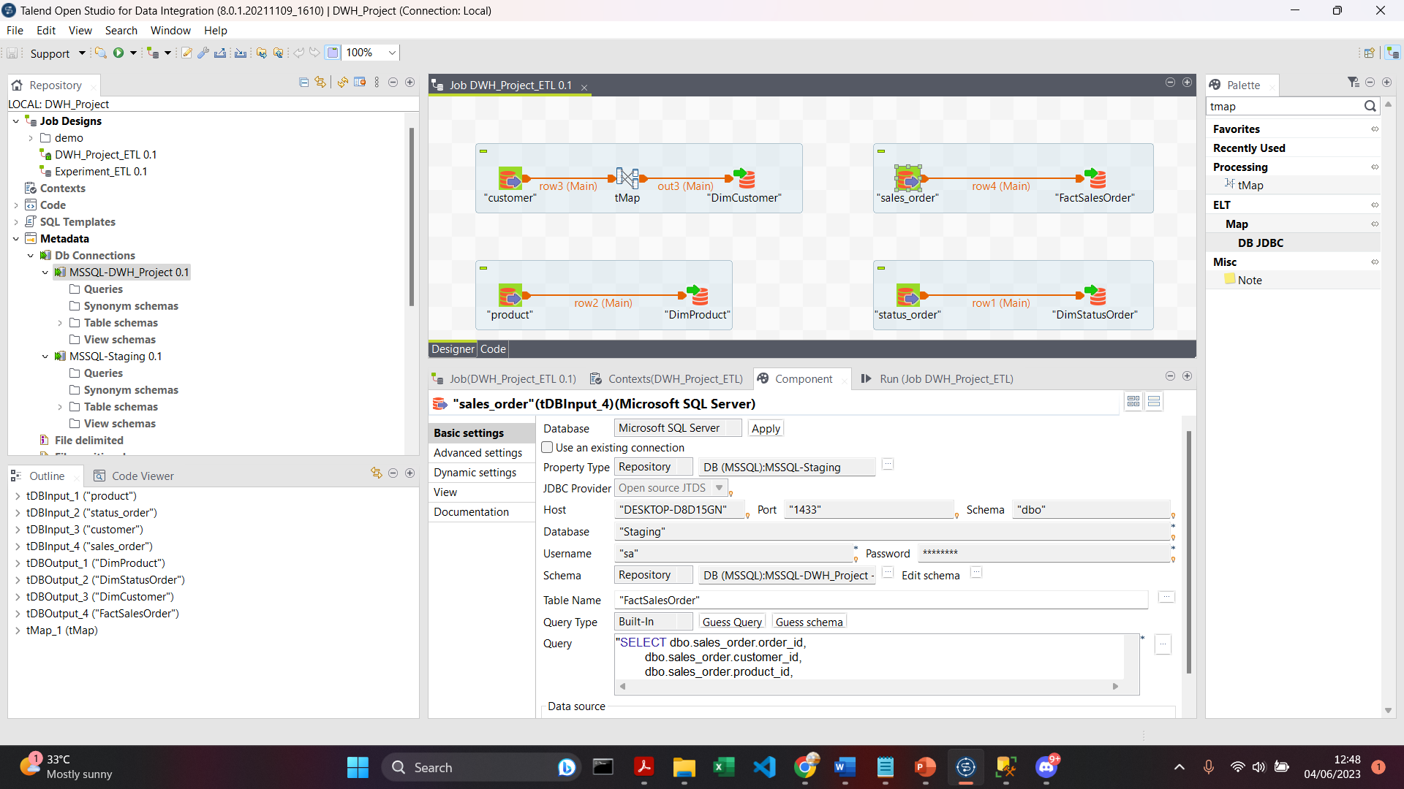
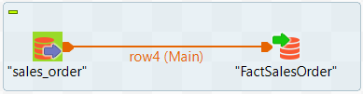
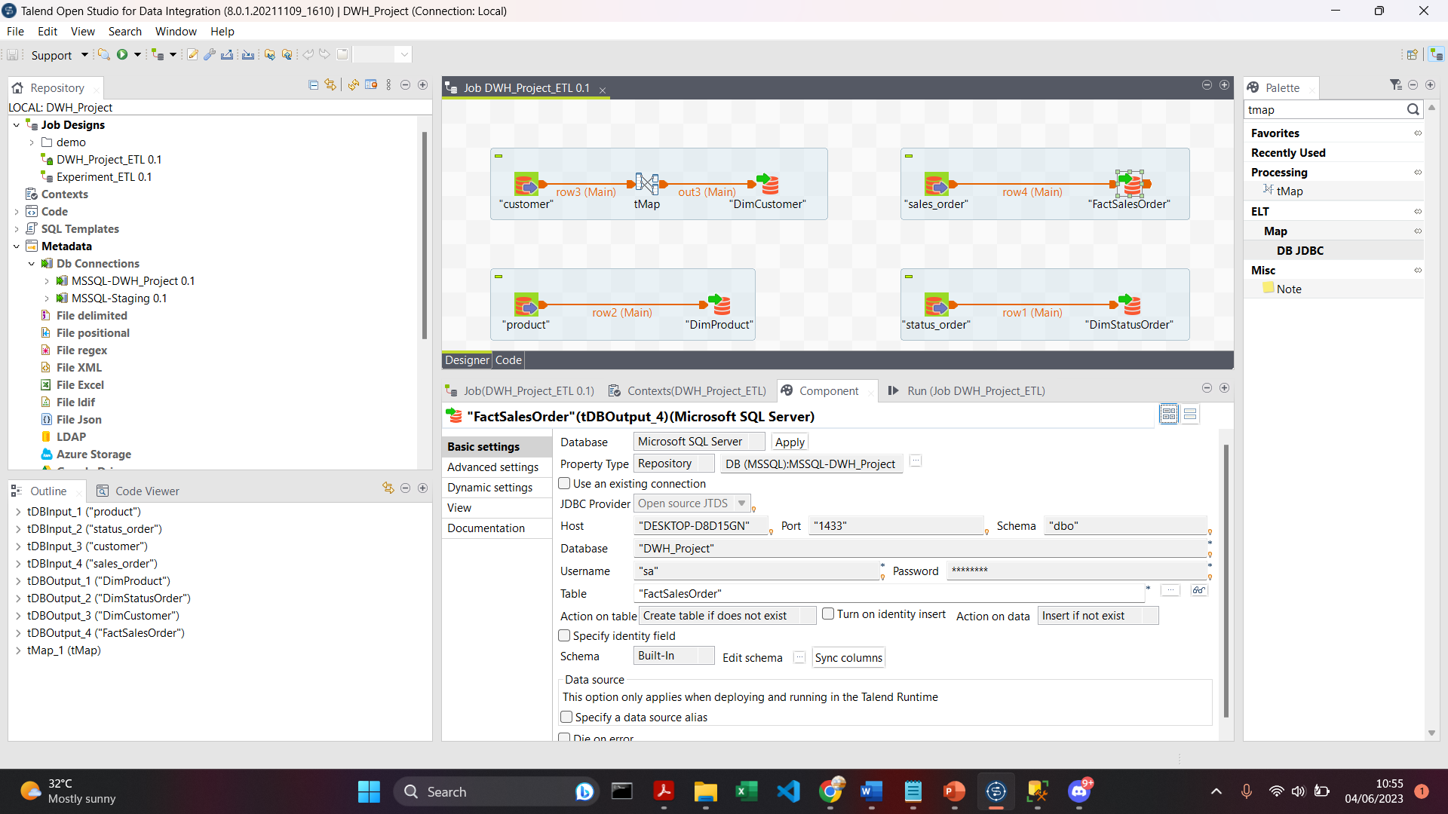
RESULT: Configure the Properties of Sales Order Components
Adjust the properties according to databases by entering values, selecting options from drop-down menus, or configuring connections.

Slide 17
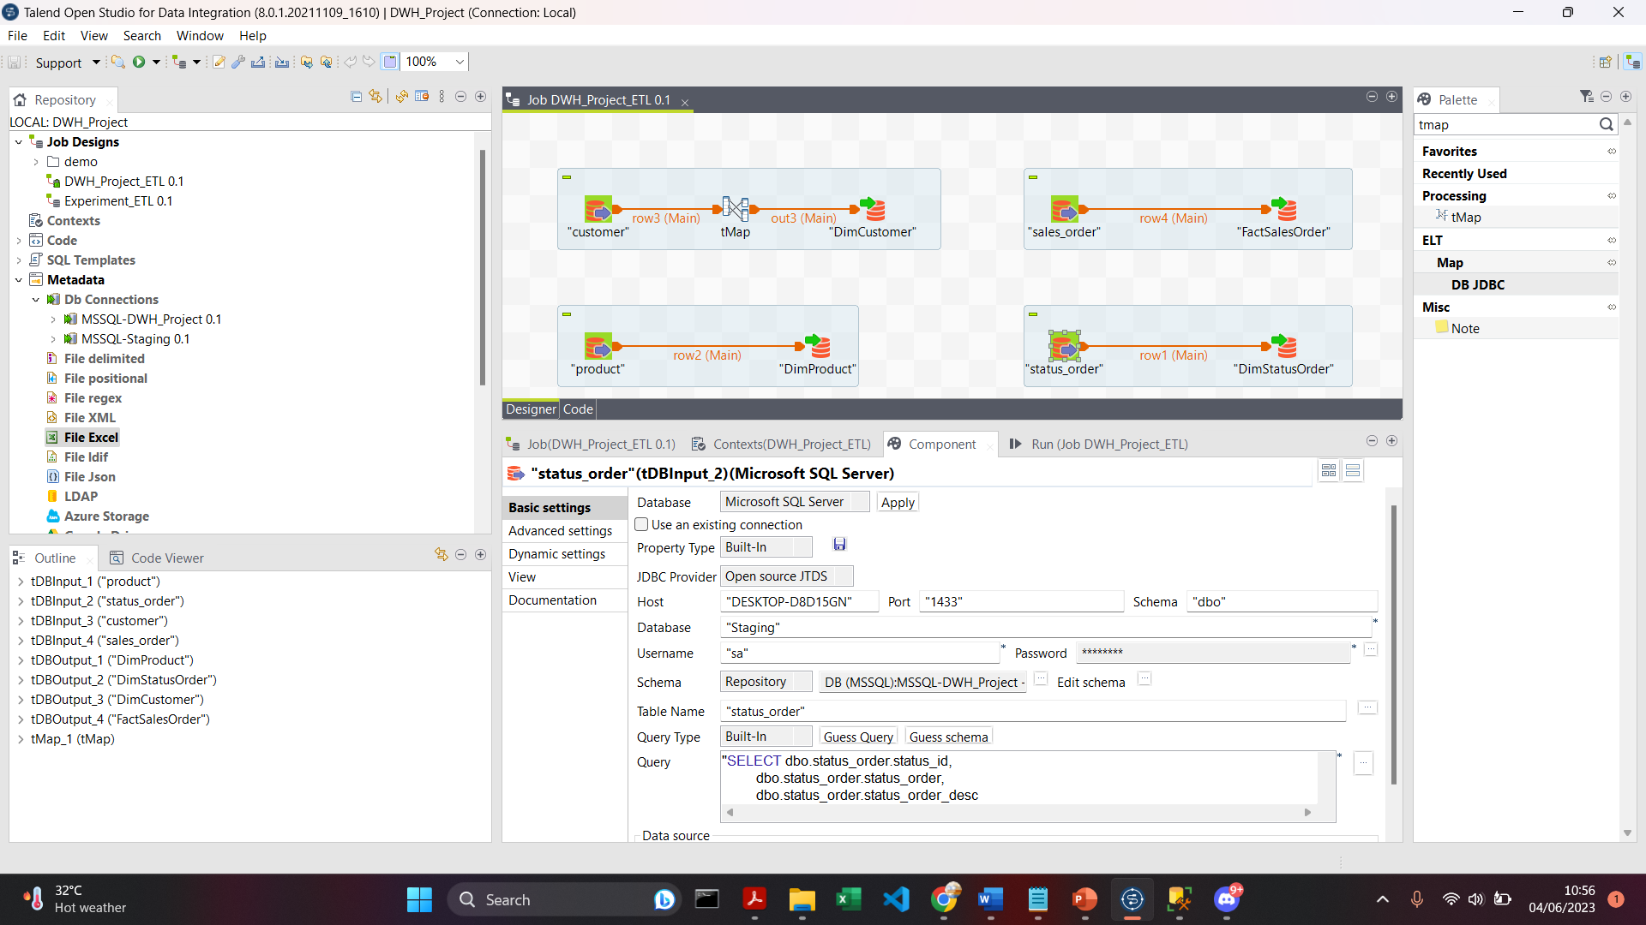
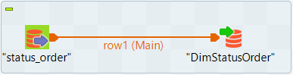

RESULT: Configure the Properties of Status Order Components
Adjust the properties according to databases by entering values, selecting options from drop-down menus, or configuring connections.

Slide 18
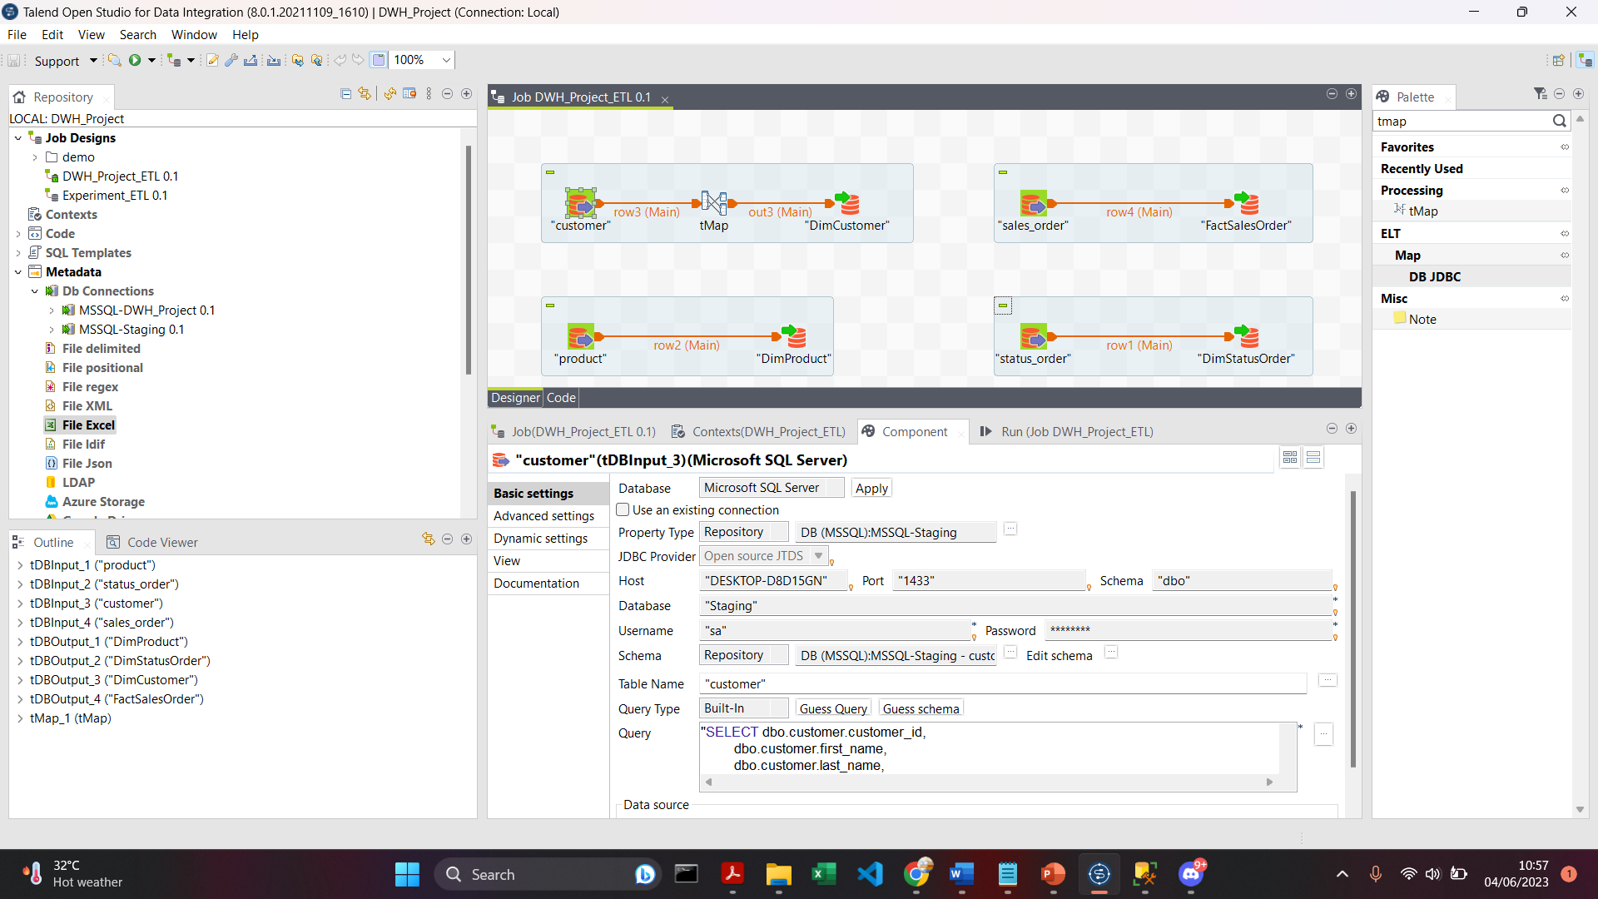
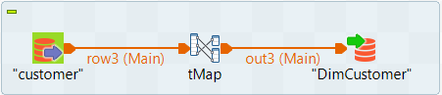
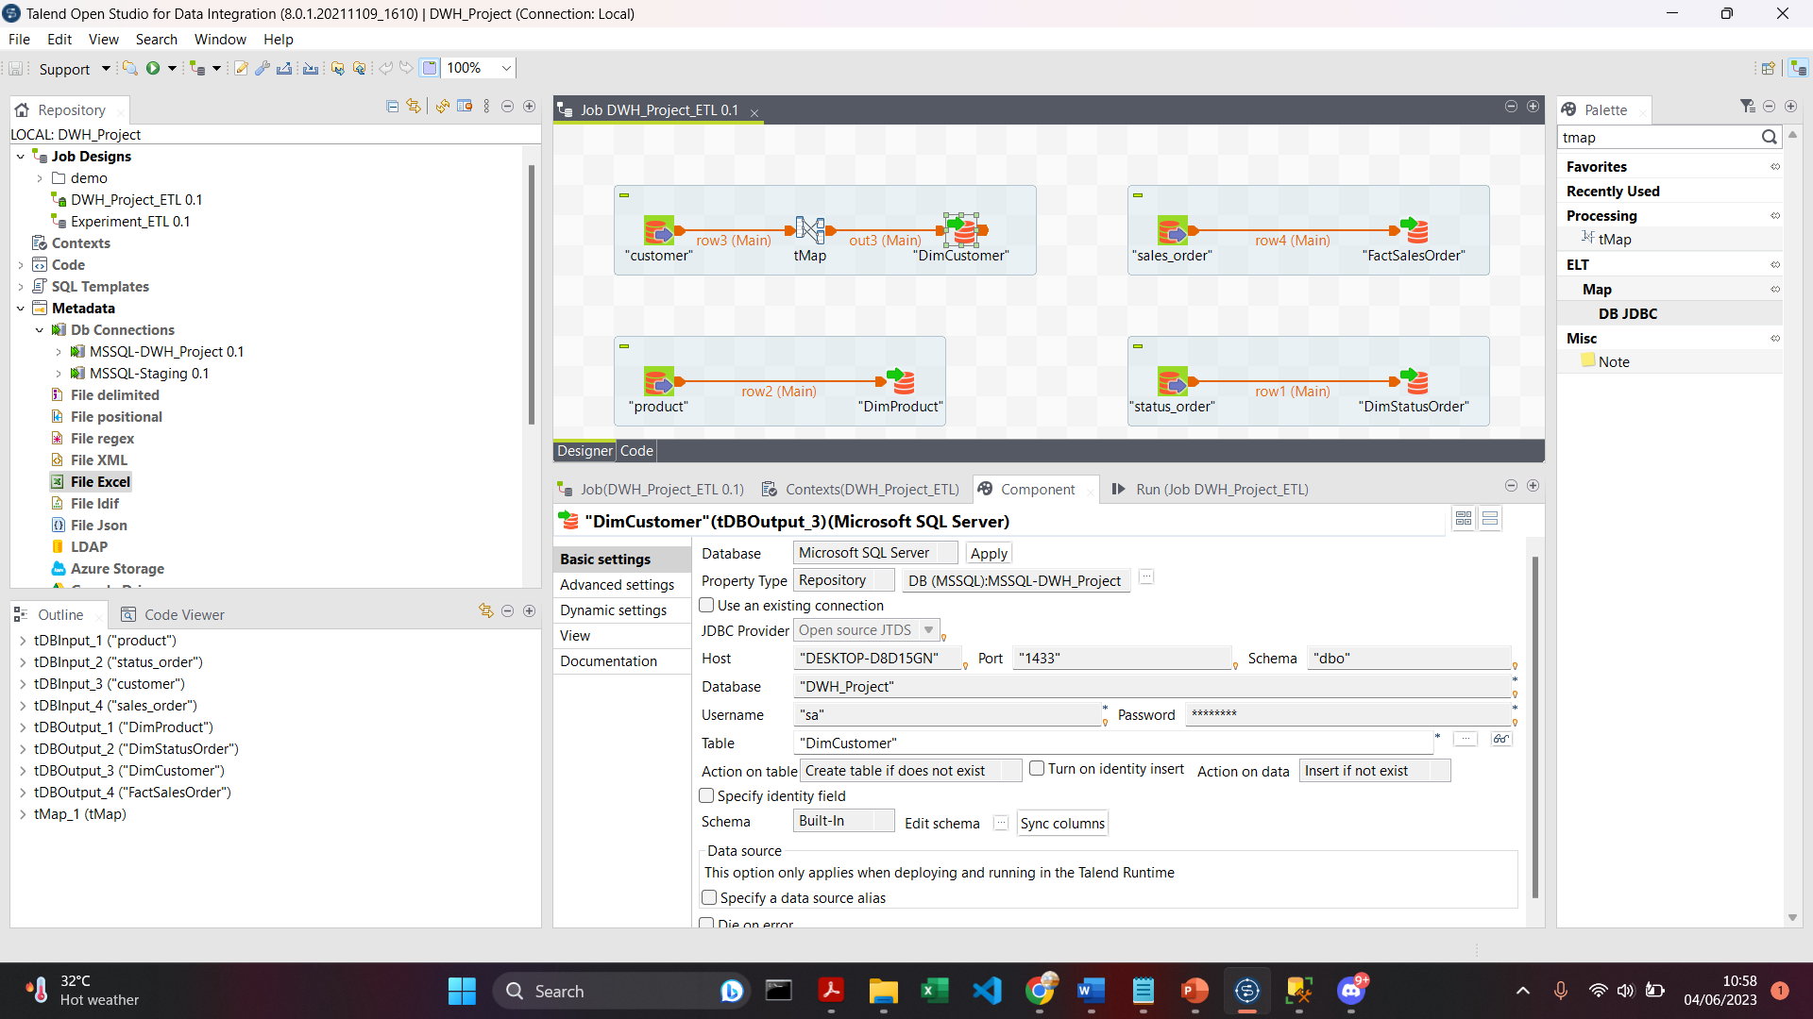
RESULT: Configure the Properties of Customer Components
Adjust the properties according to databases by entering values, selecting options from drop-down menus, or configuring connections.

Slide 19
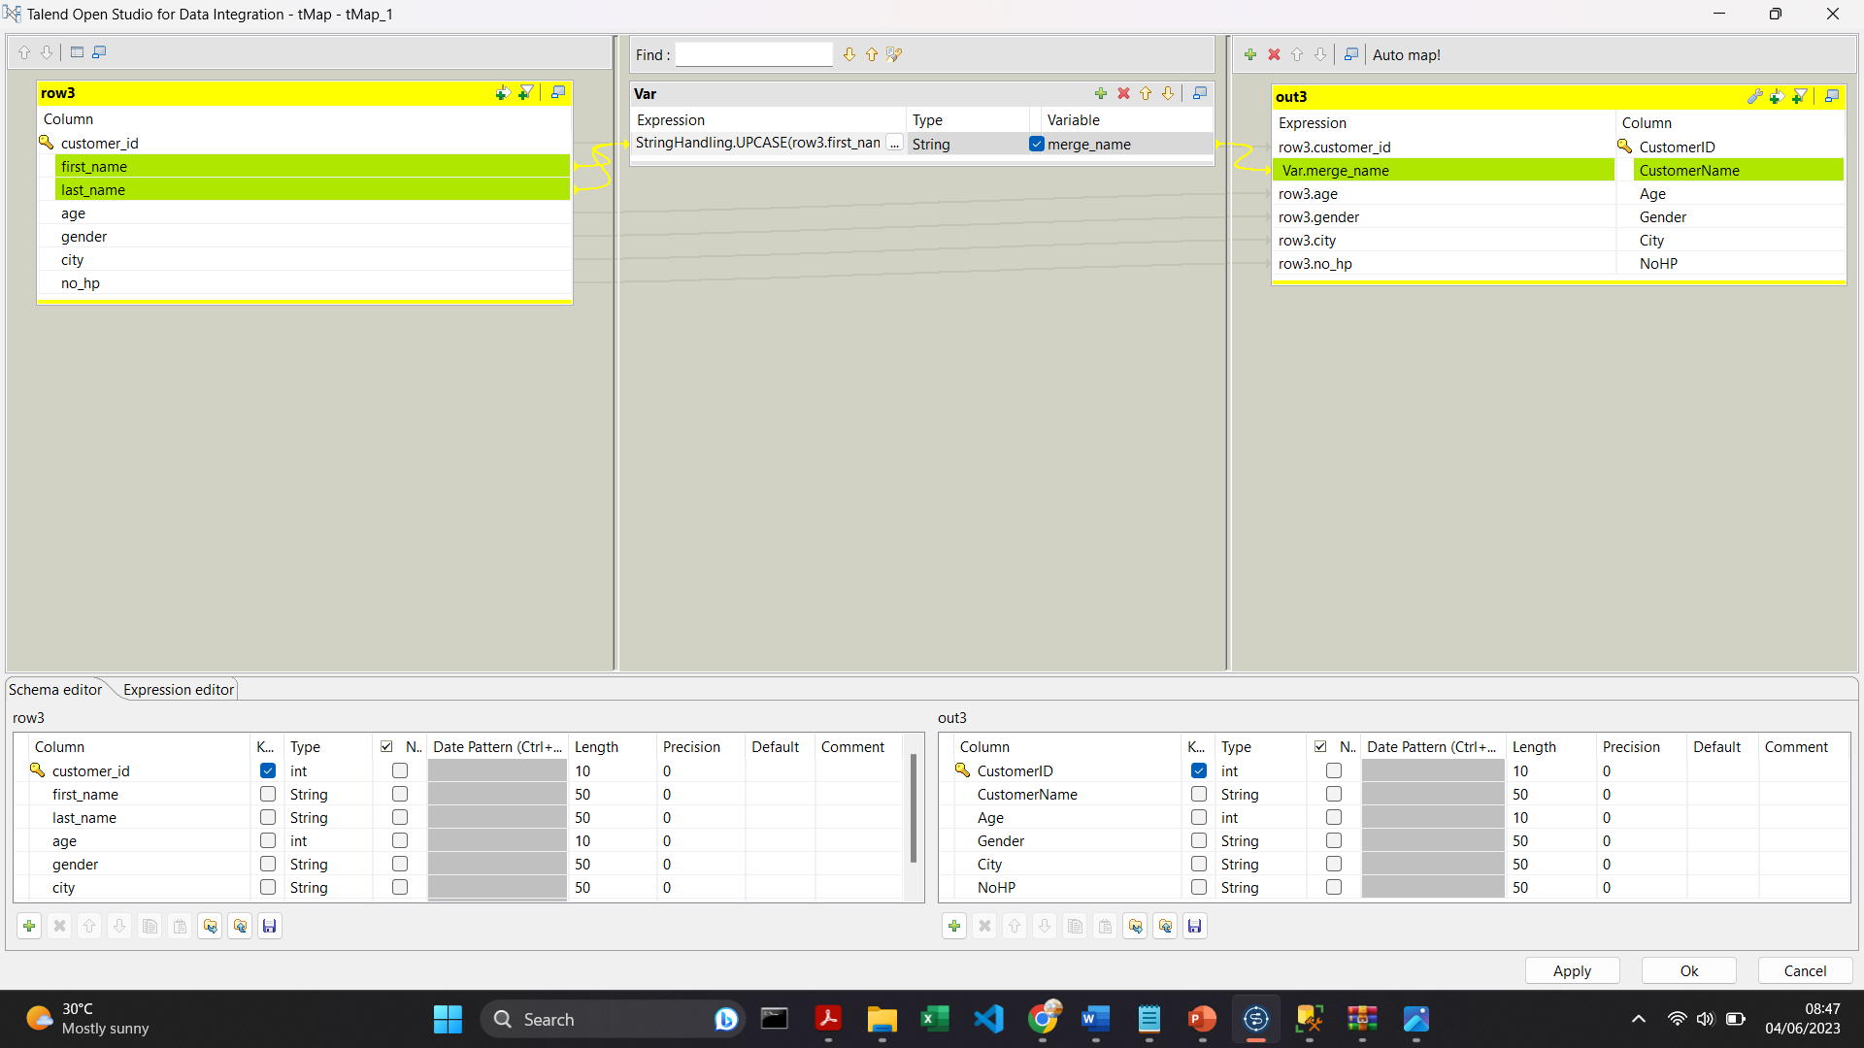
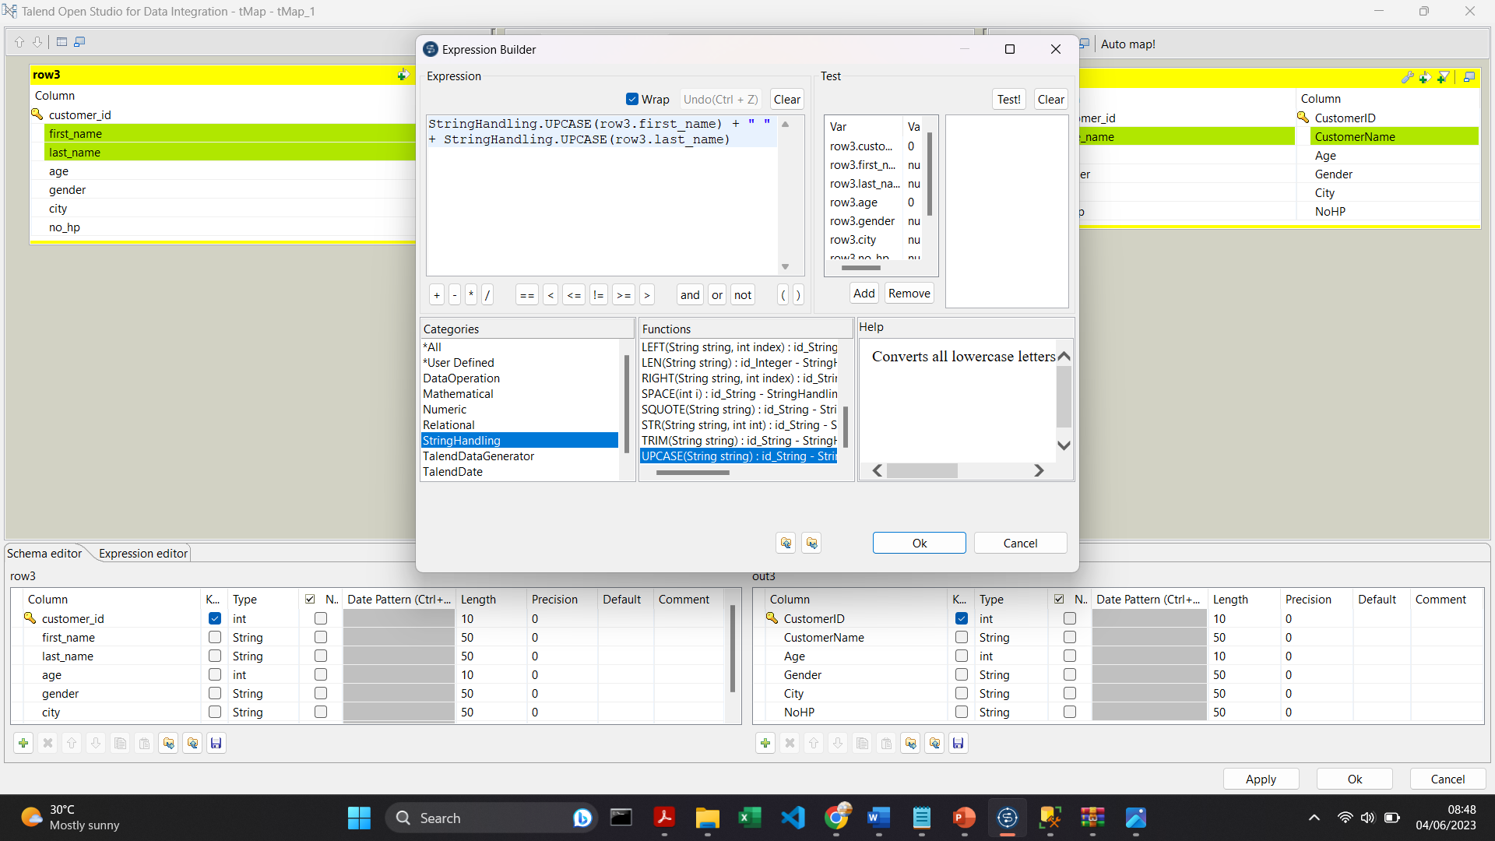
RESULT: tMap Configurations
In tMap, the UPCASE function is used to convert letters to uppercase, and the plus (+) operator is used to concatenate two columns. These functions are readily available within the tMap component.
Combine the FirstName and LastName columns into a single column named CustomerName.

Slide 20
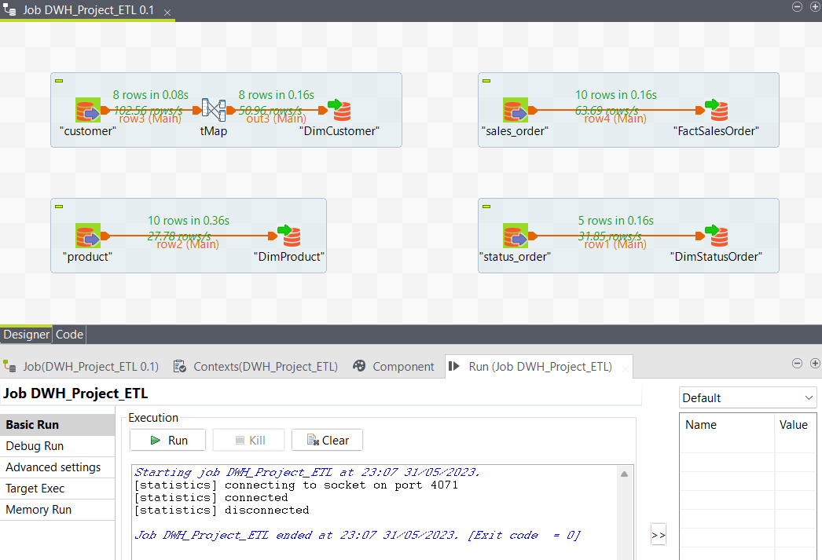
RESULT: Execute an ETL Job
Once the job is built and validated successfully, then execute it. Here is the result:

Slide 21
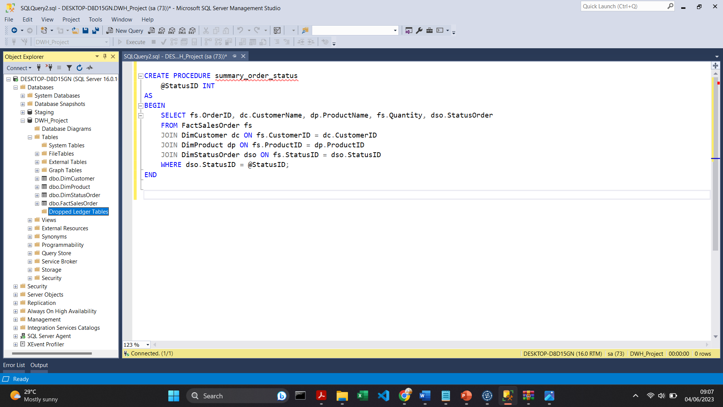
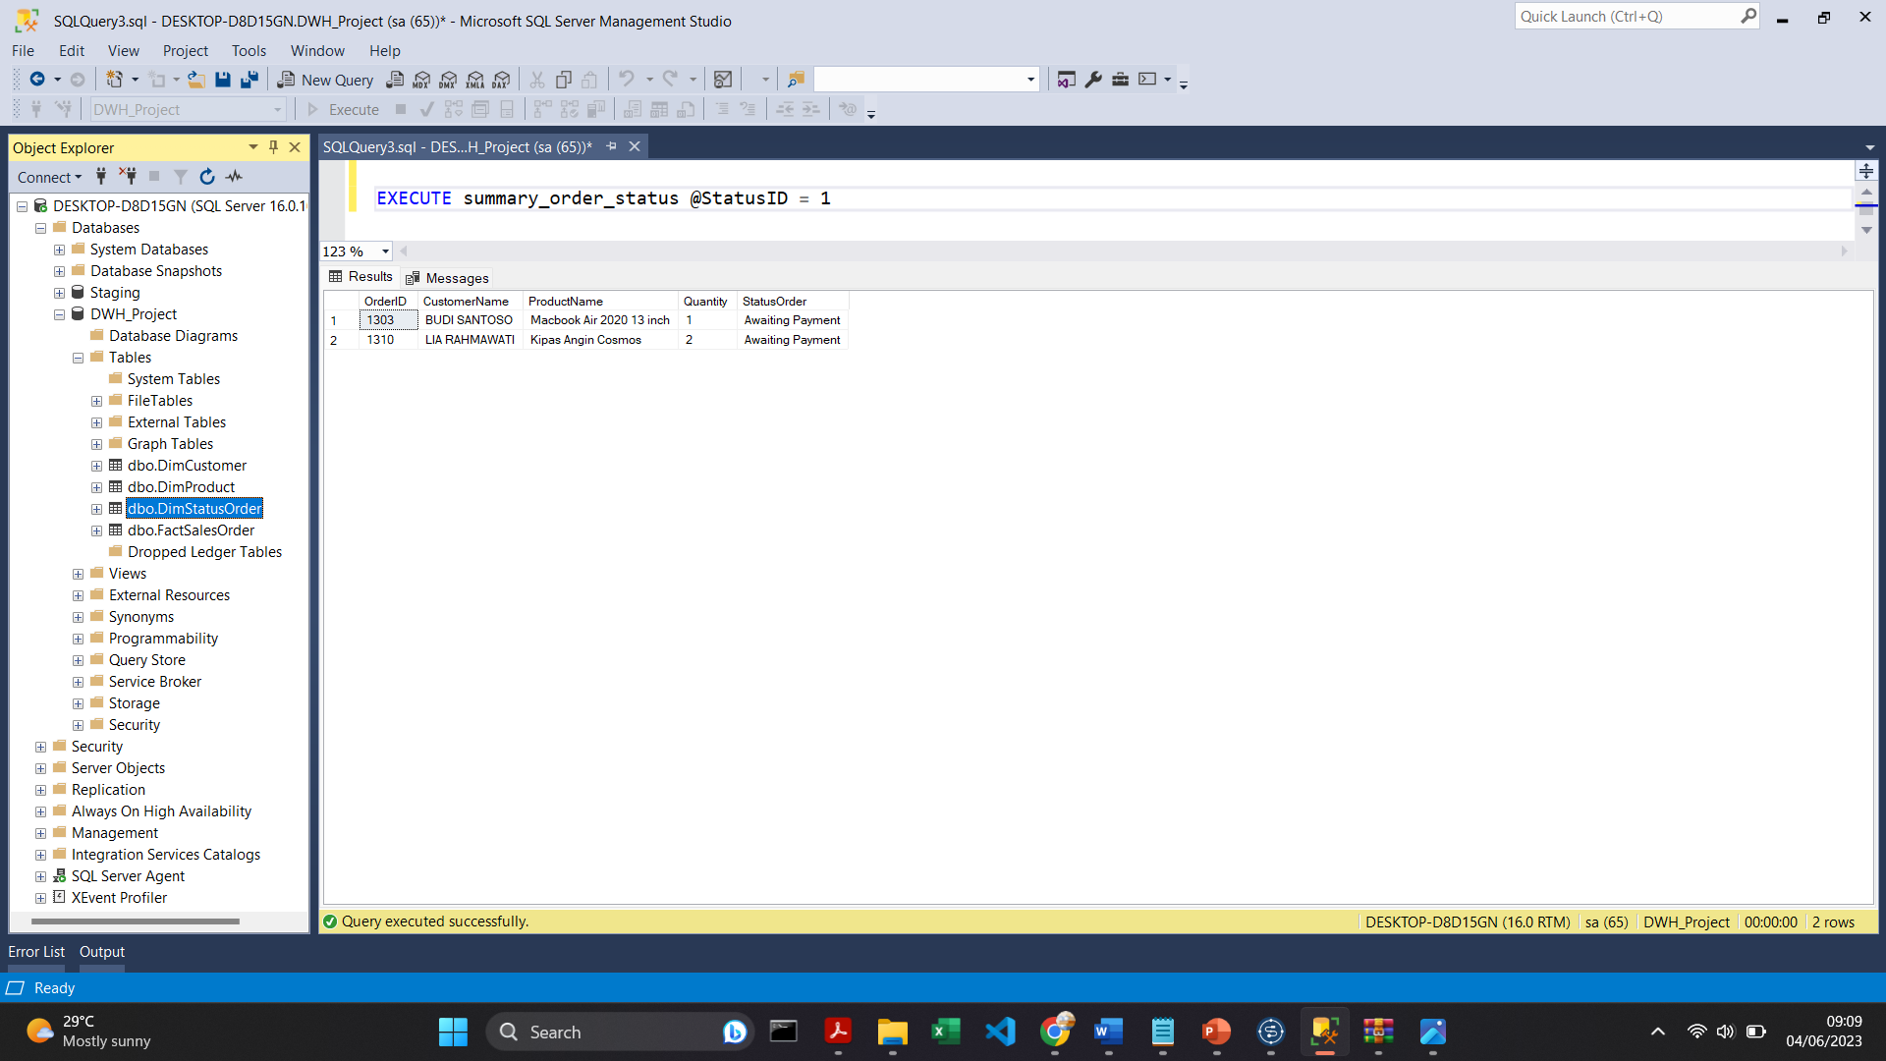
RESULT: Create Stored Procedure
Create a stored procedure called "summary_order_status" that includes a SELECT statement and performs a JOIN operation between the fact table and dimension tables.
Additionally, create a parameter named StatusID, derived from the StatusID column in the DimStatusOrder table, to filter the query results based on the provided value. To execute this stored procedure, use the following syntax: EXEC summary_order_status @StatusID = ???. I would choose the parameter of StatusID with 1.

Slide 22
THANKS
Contact me:
https://www.linkedin.com/in/nabila-putri-listyanto/
Link video: https://youtu.be/p3mSNMIfrdg
Link project: https://github.com/ilutysn/VIX_IDX-Partners_DE

